Slide 1
Il Principe: A slight detour into Principal Components
Joren Janzing

Slide 2
Content
PCA Analysis
Overview Plots

Slide 4
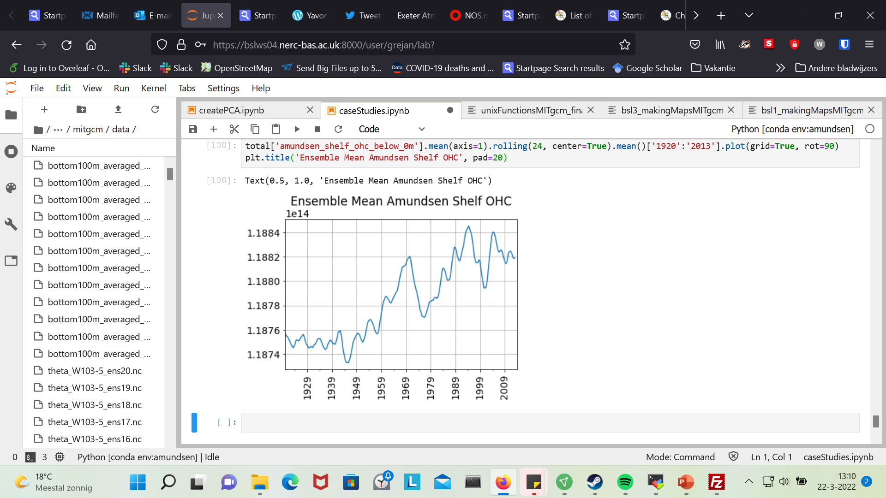
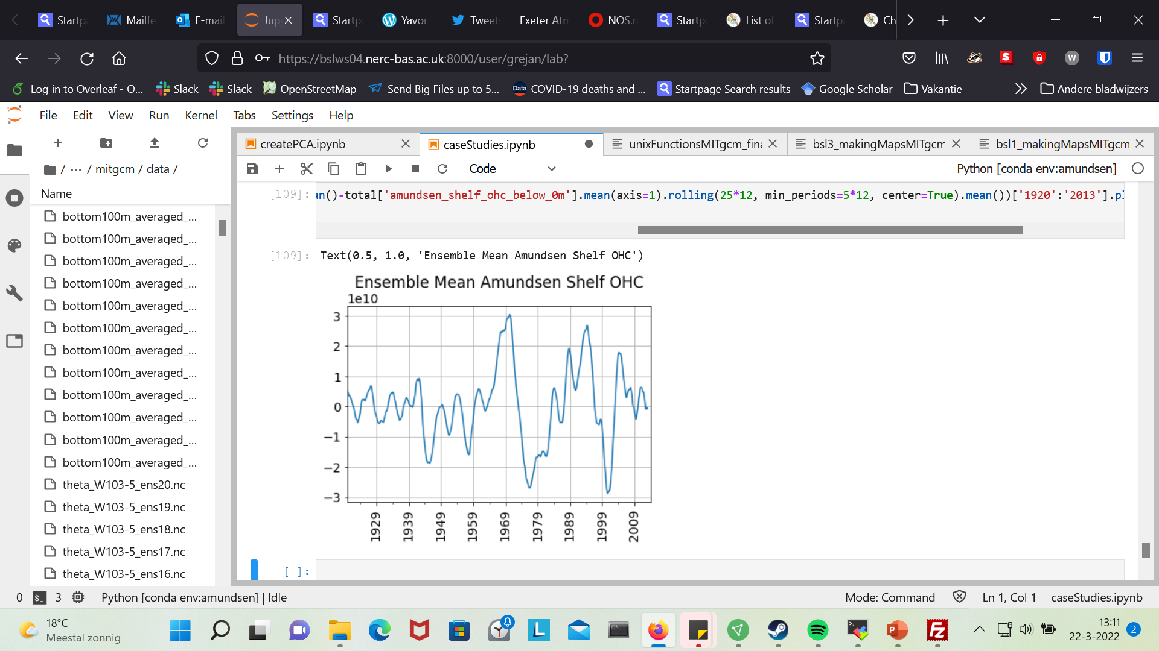
Context

Slide 5
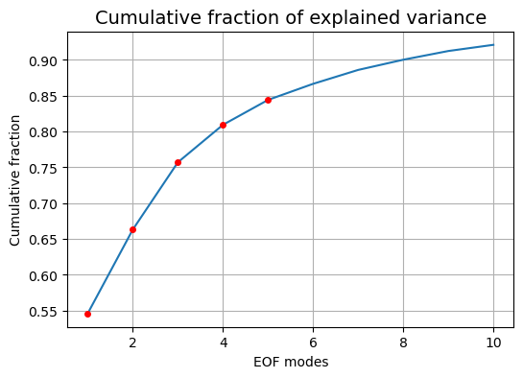
PCA of Ensemble Mean of Amundsen Shelf Temp
First 10 components explain roughly 90 percent of variance (!)

Slide 6
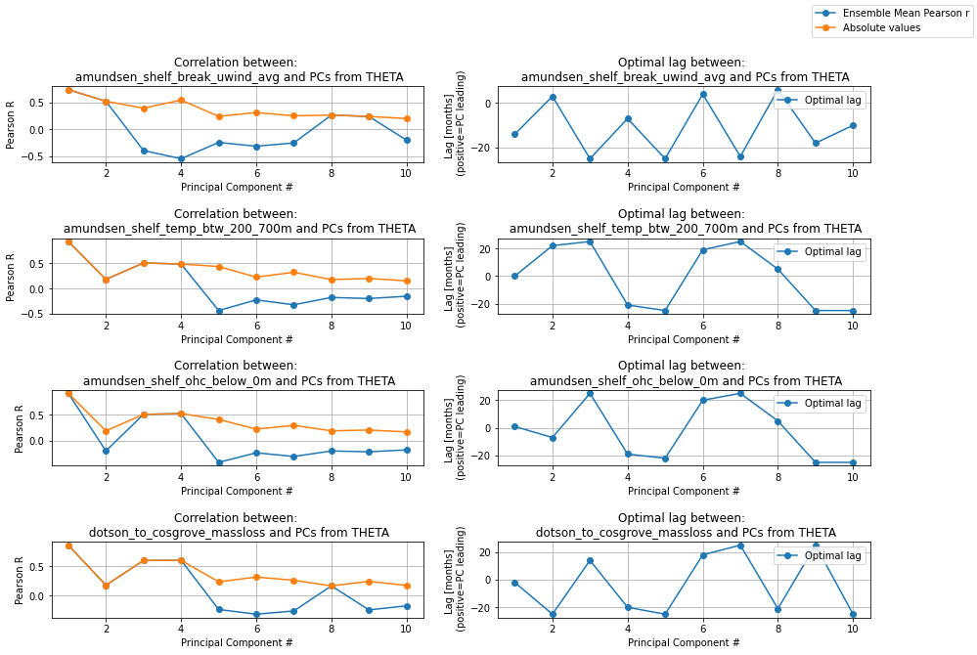

Slide 7
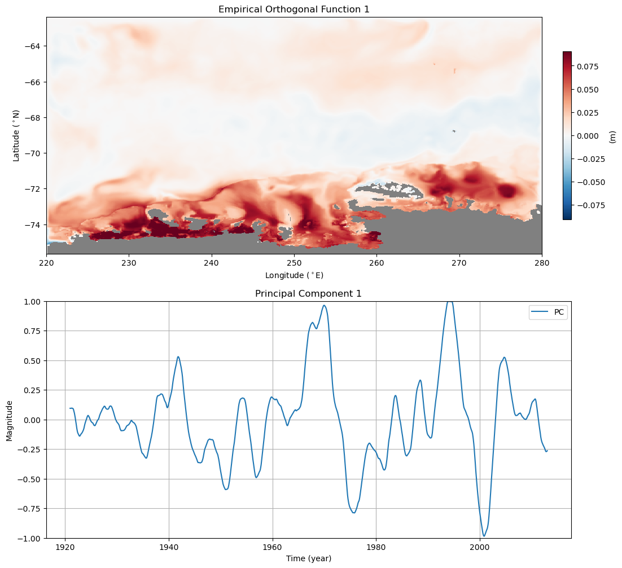
Timing: same time as event

Slide 8
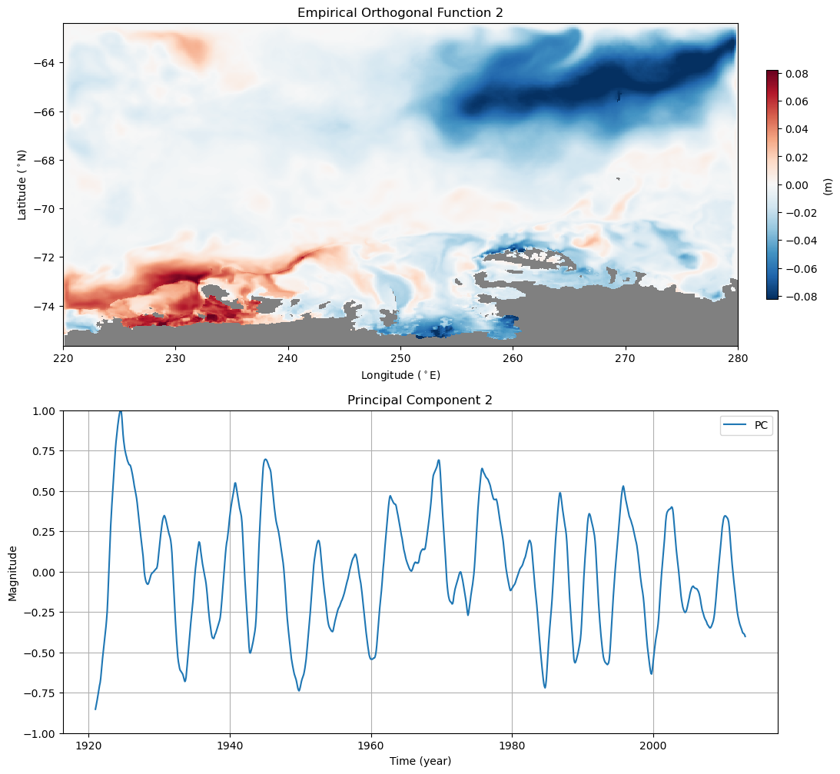
Timing: same time as wind

Slide 9
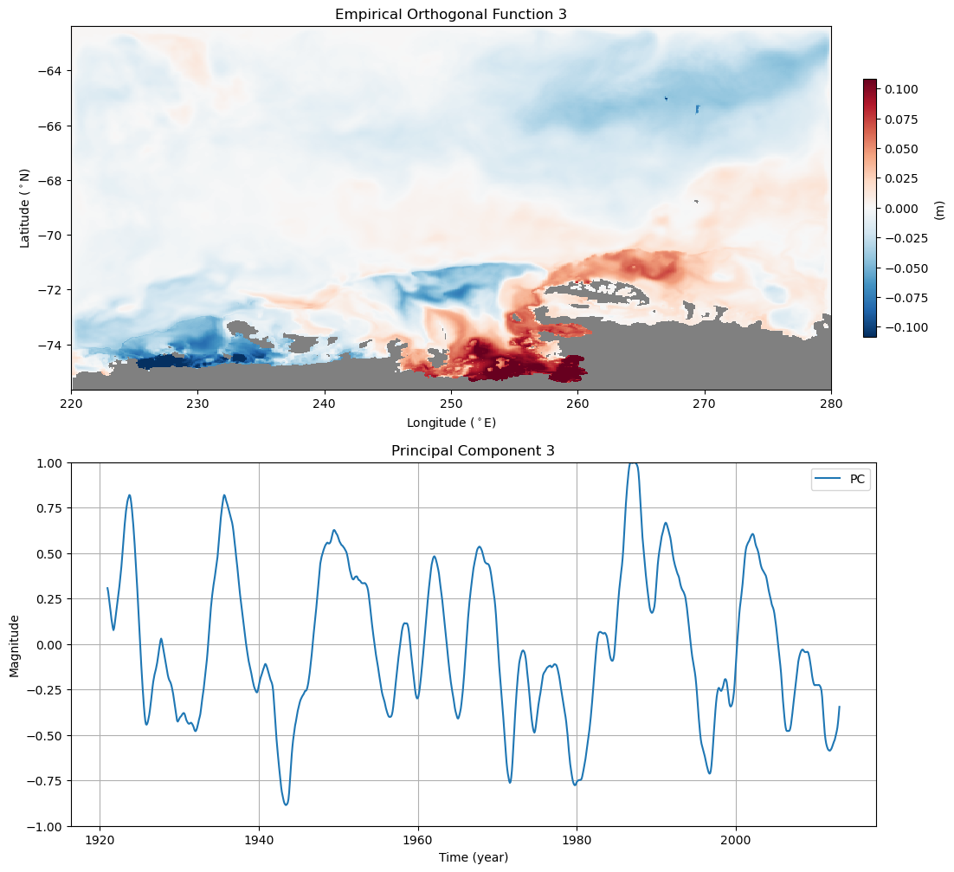
Timing: before event

Slide 10
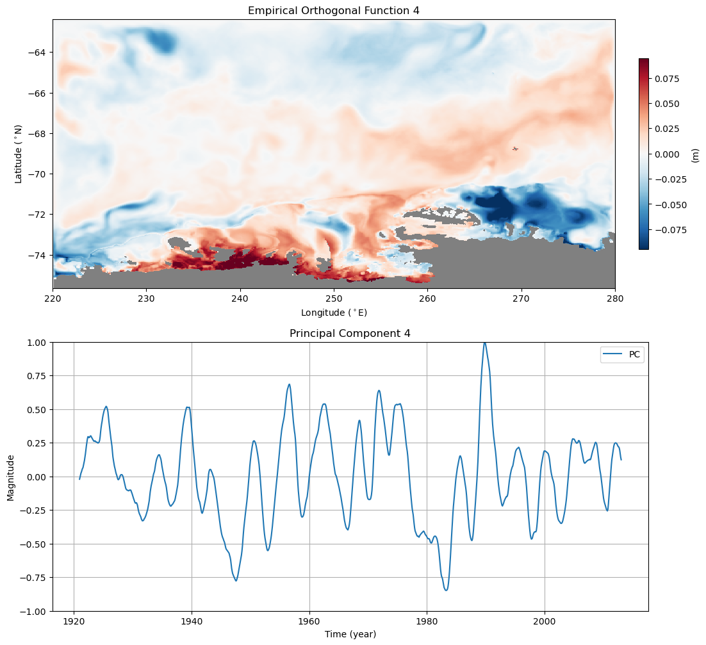
Timing: after event

Slide 11
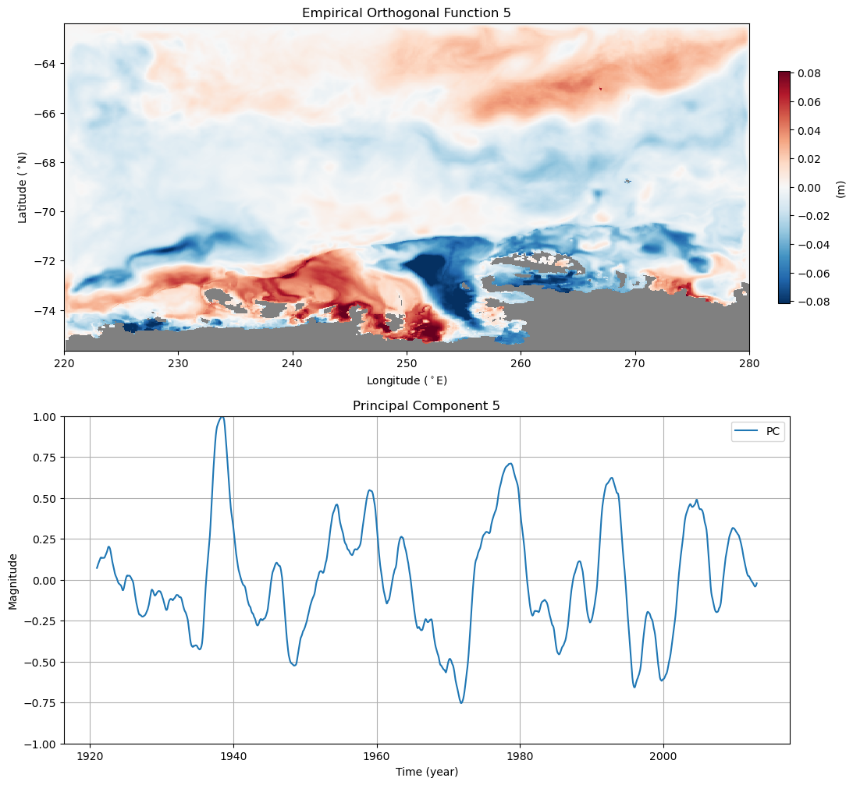
Timing:
after event
NOTE: negative correlation!

Slide 12
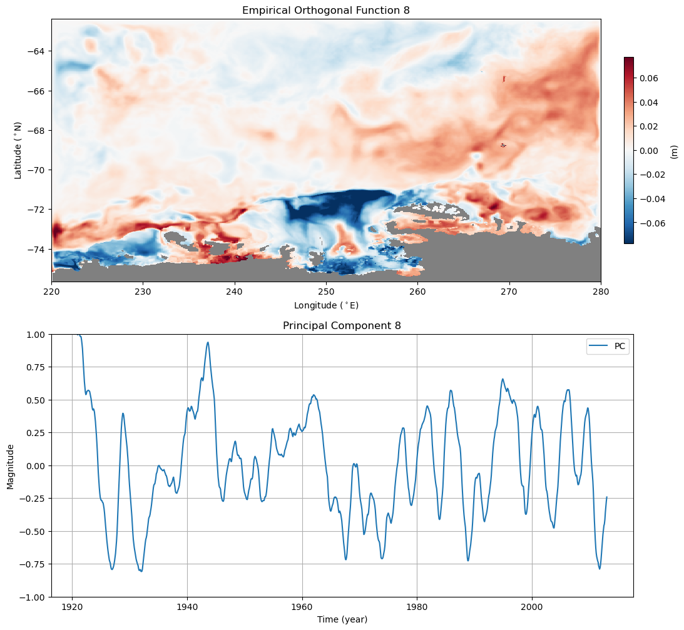

Slide 13
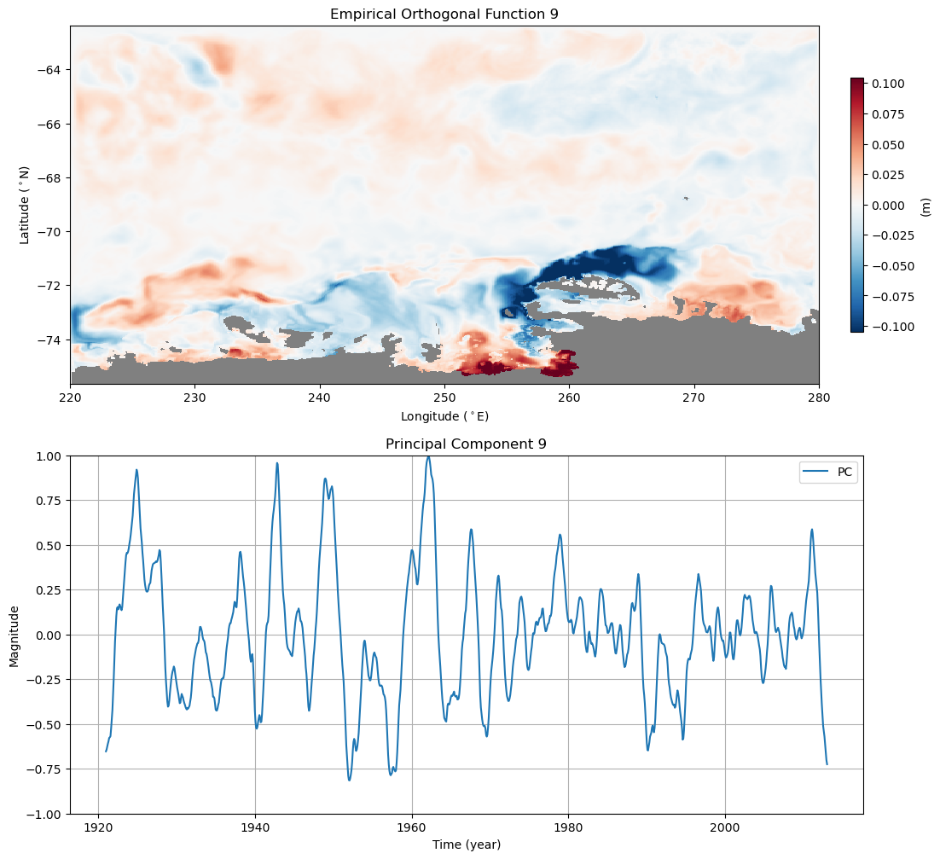

Slide 14
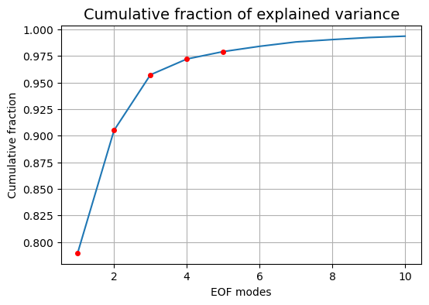
PCA of Ensemble Mean of Cumulative Zonal Wind

Slide 15
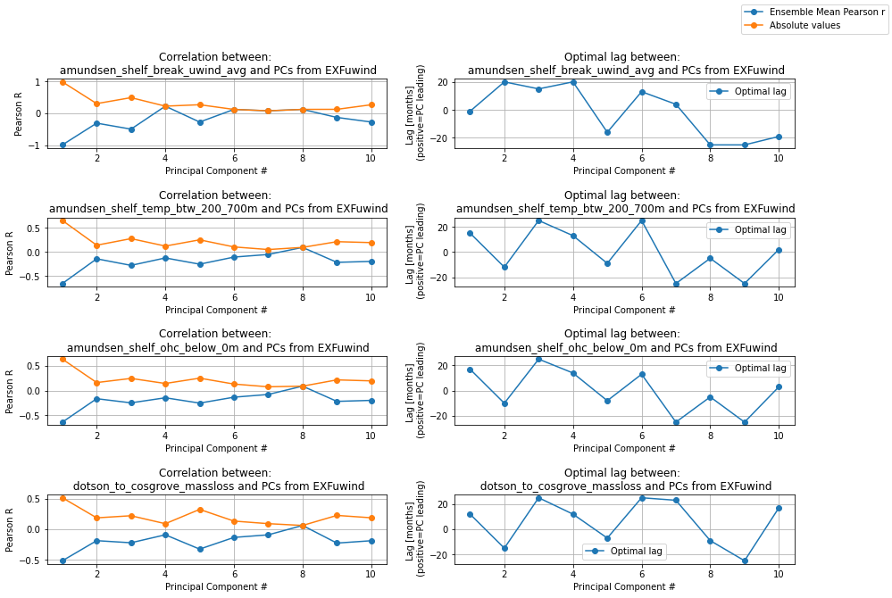
Normal Zonal Wind

Slide 16
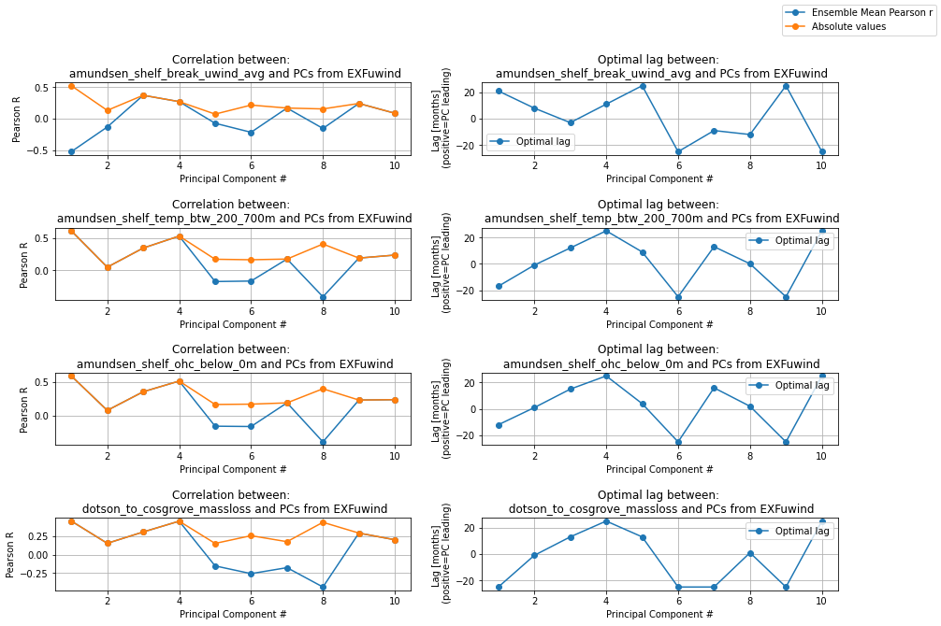
Cumulative Zonal Wind

Slide 17
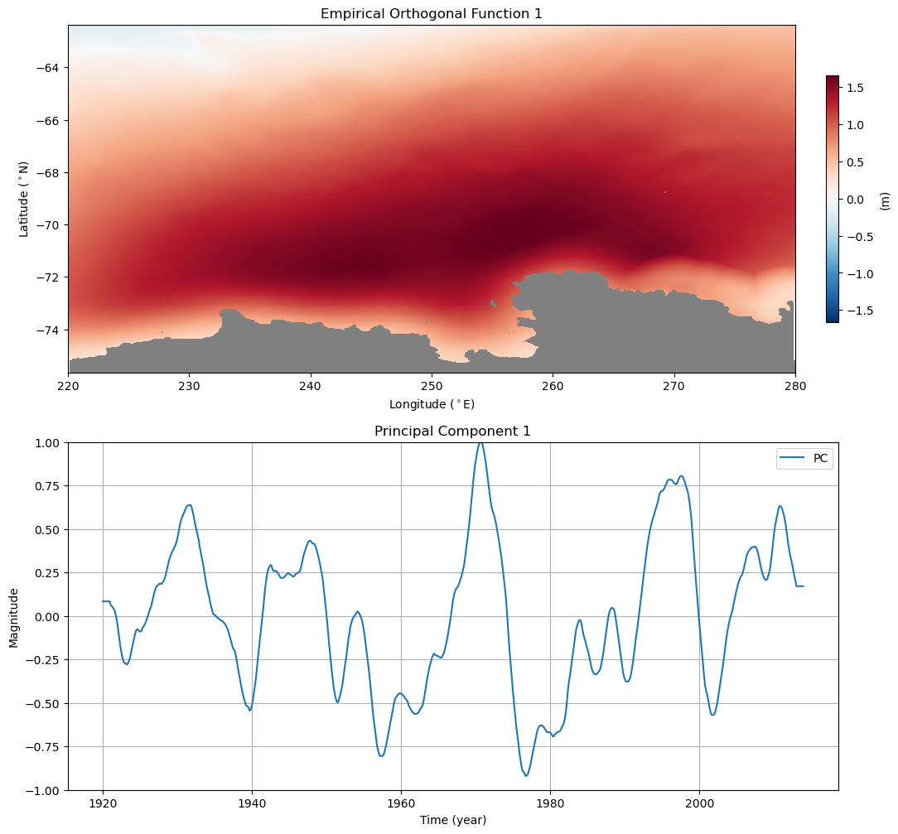
Timing:
Lagging behind event!

Slide 18
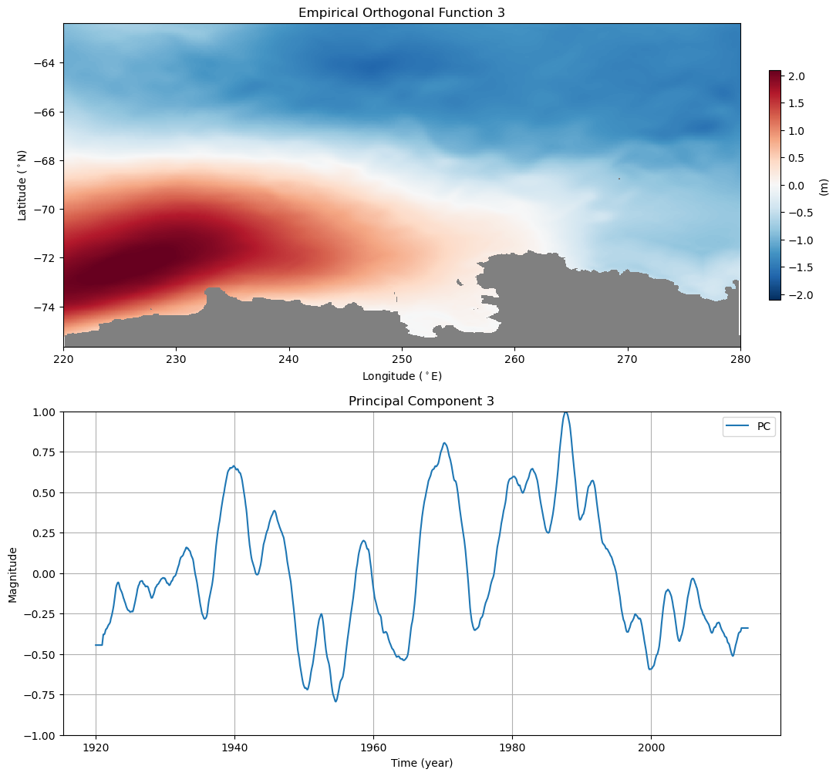
Timing:
Before event

Slide 19
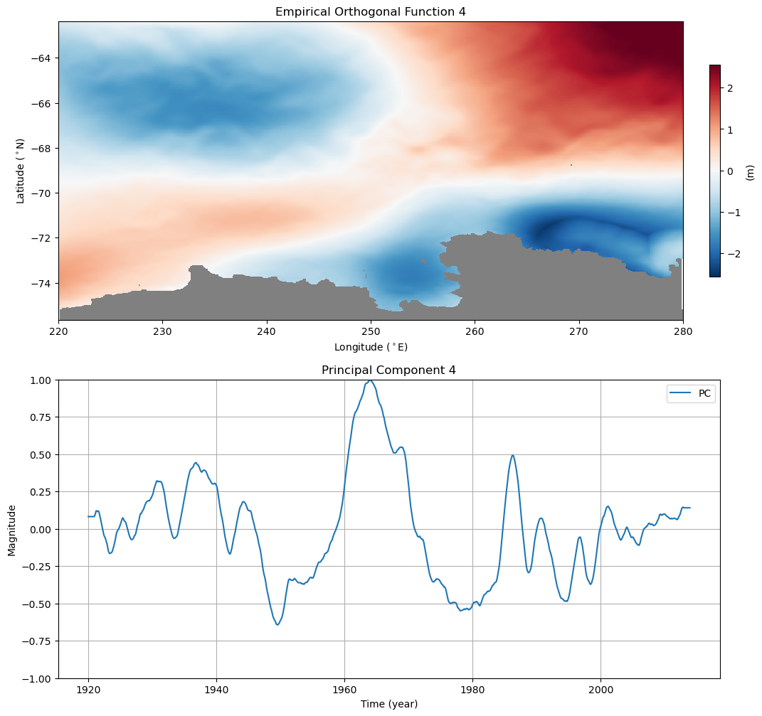
Timing:
before event!

Slide 20
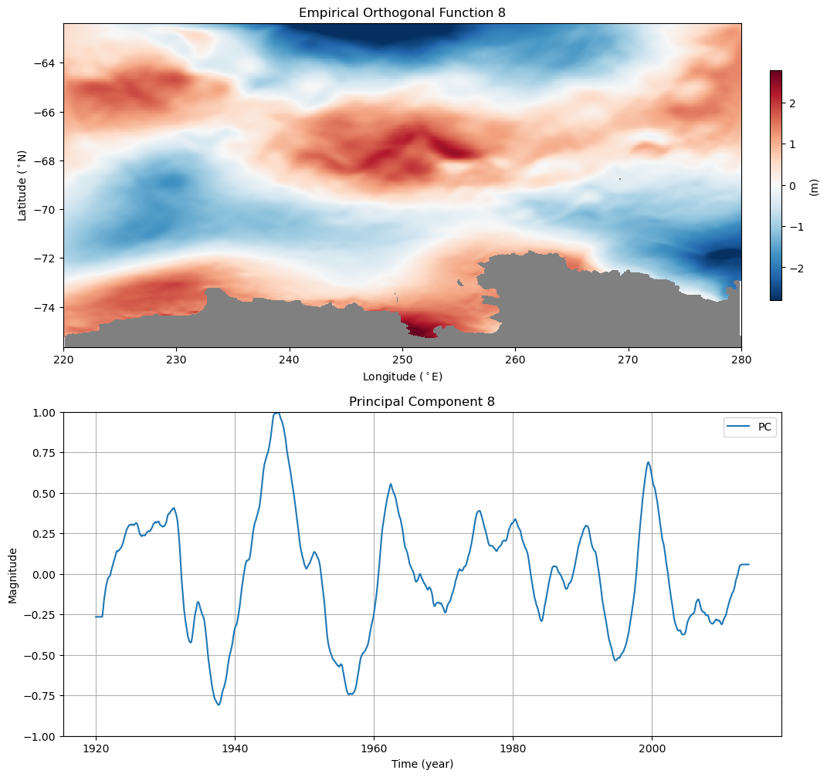
Timing:
Same time as event.
Note: NEGATIVE CORRELATION

Slide 21
Overview Plots

Slide 22
Member 8

Slide 23
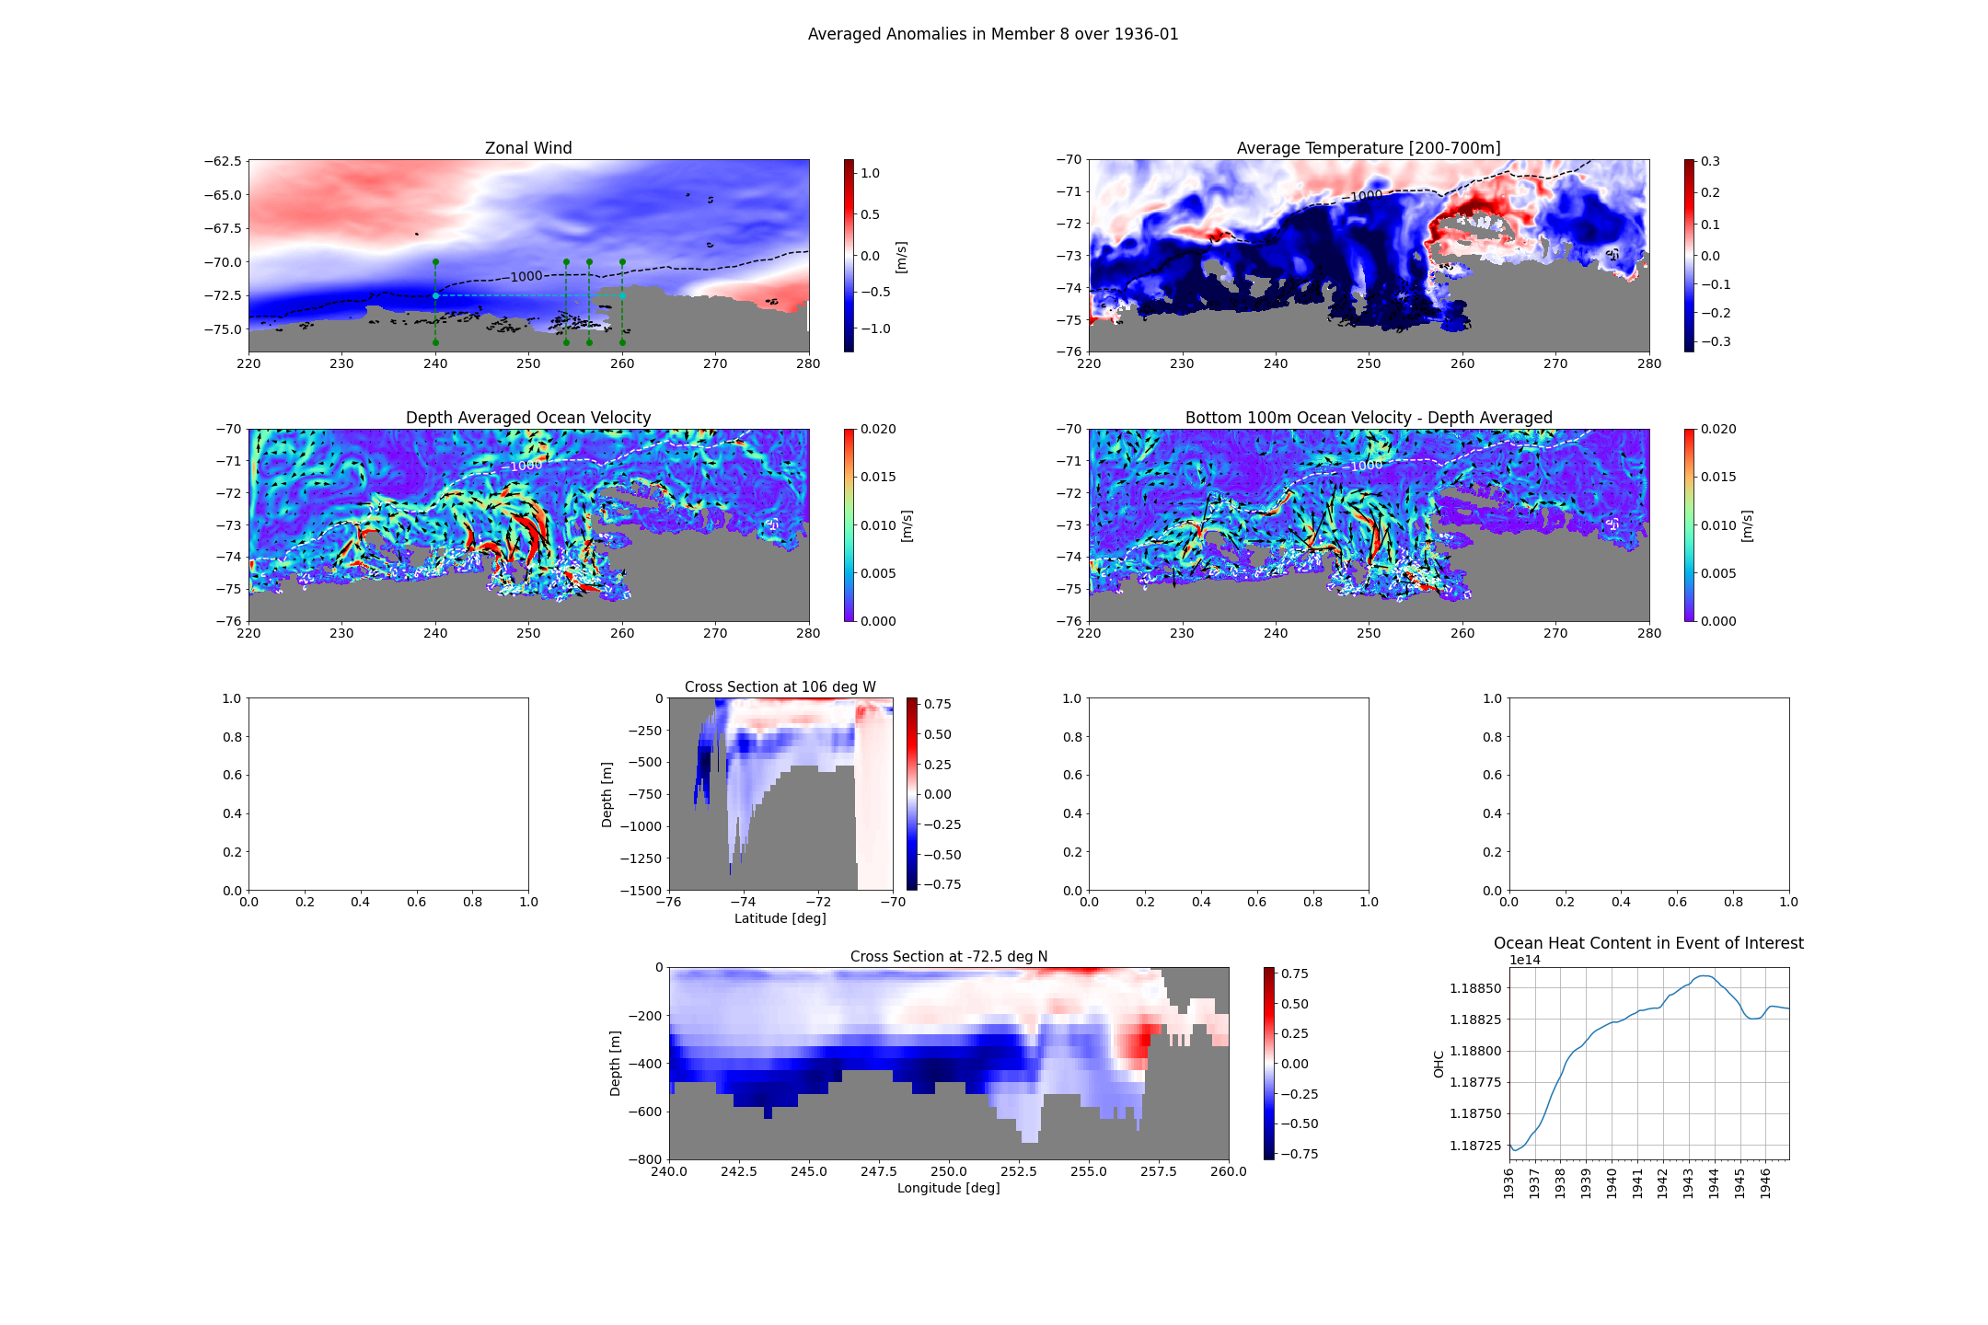

Slide 24
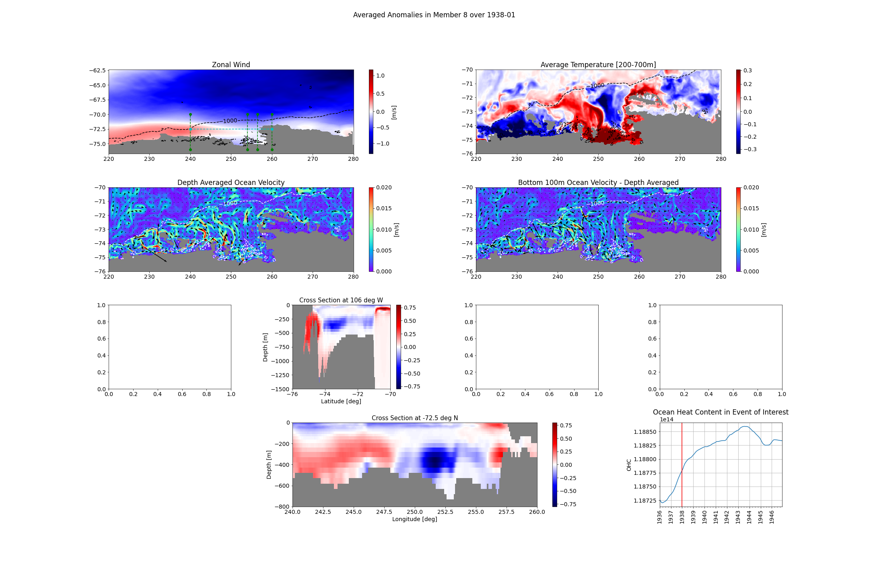

Slide 25
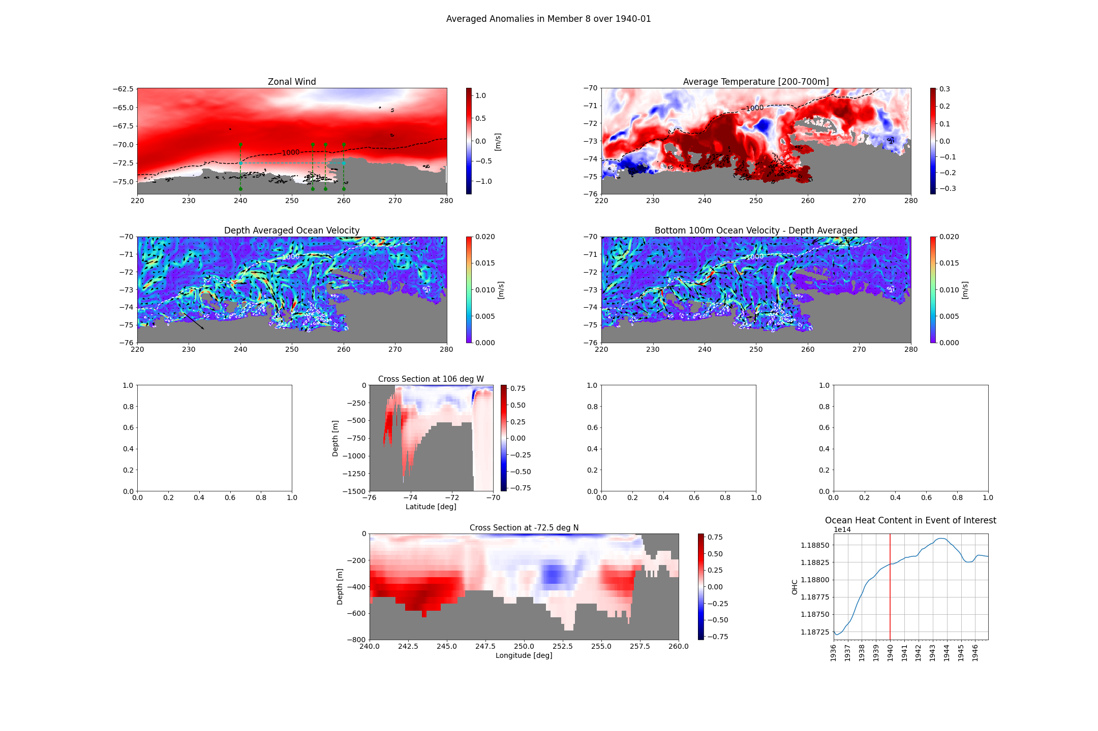

Slide 26
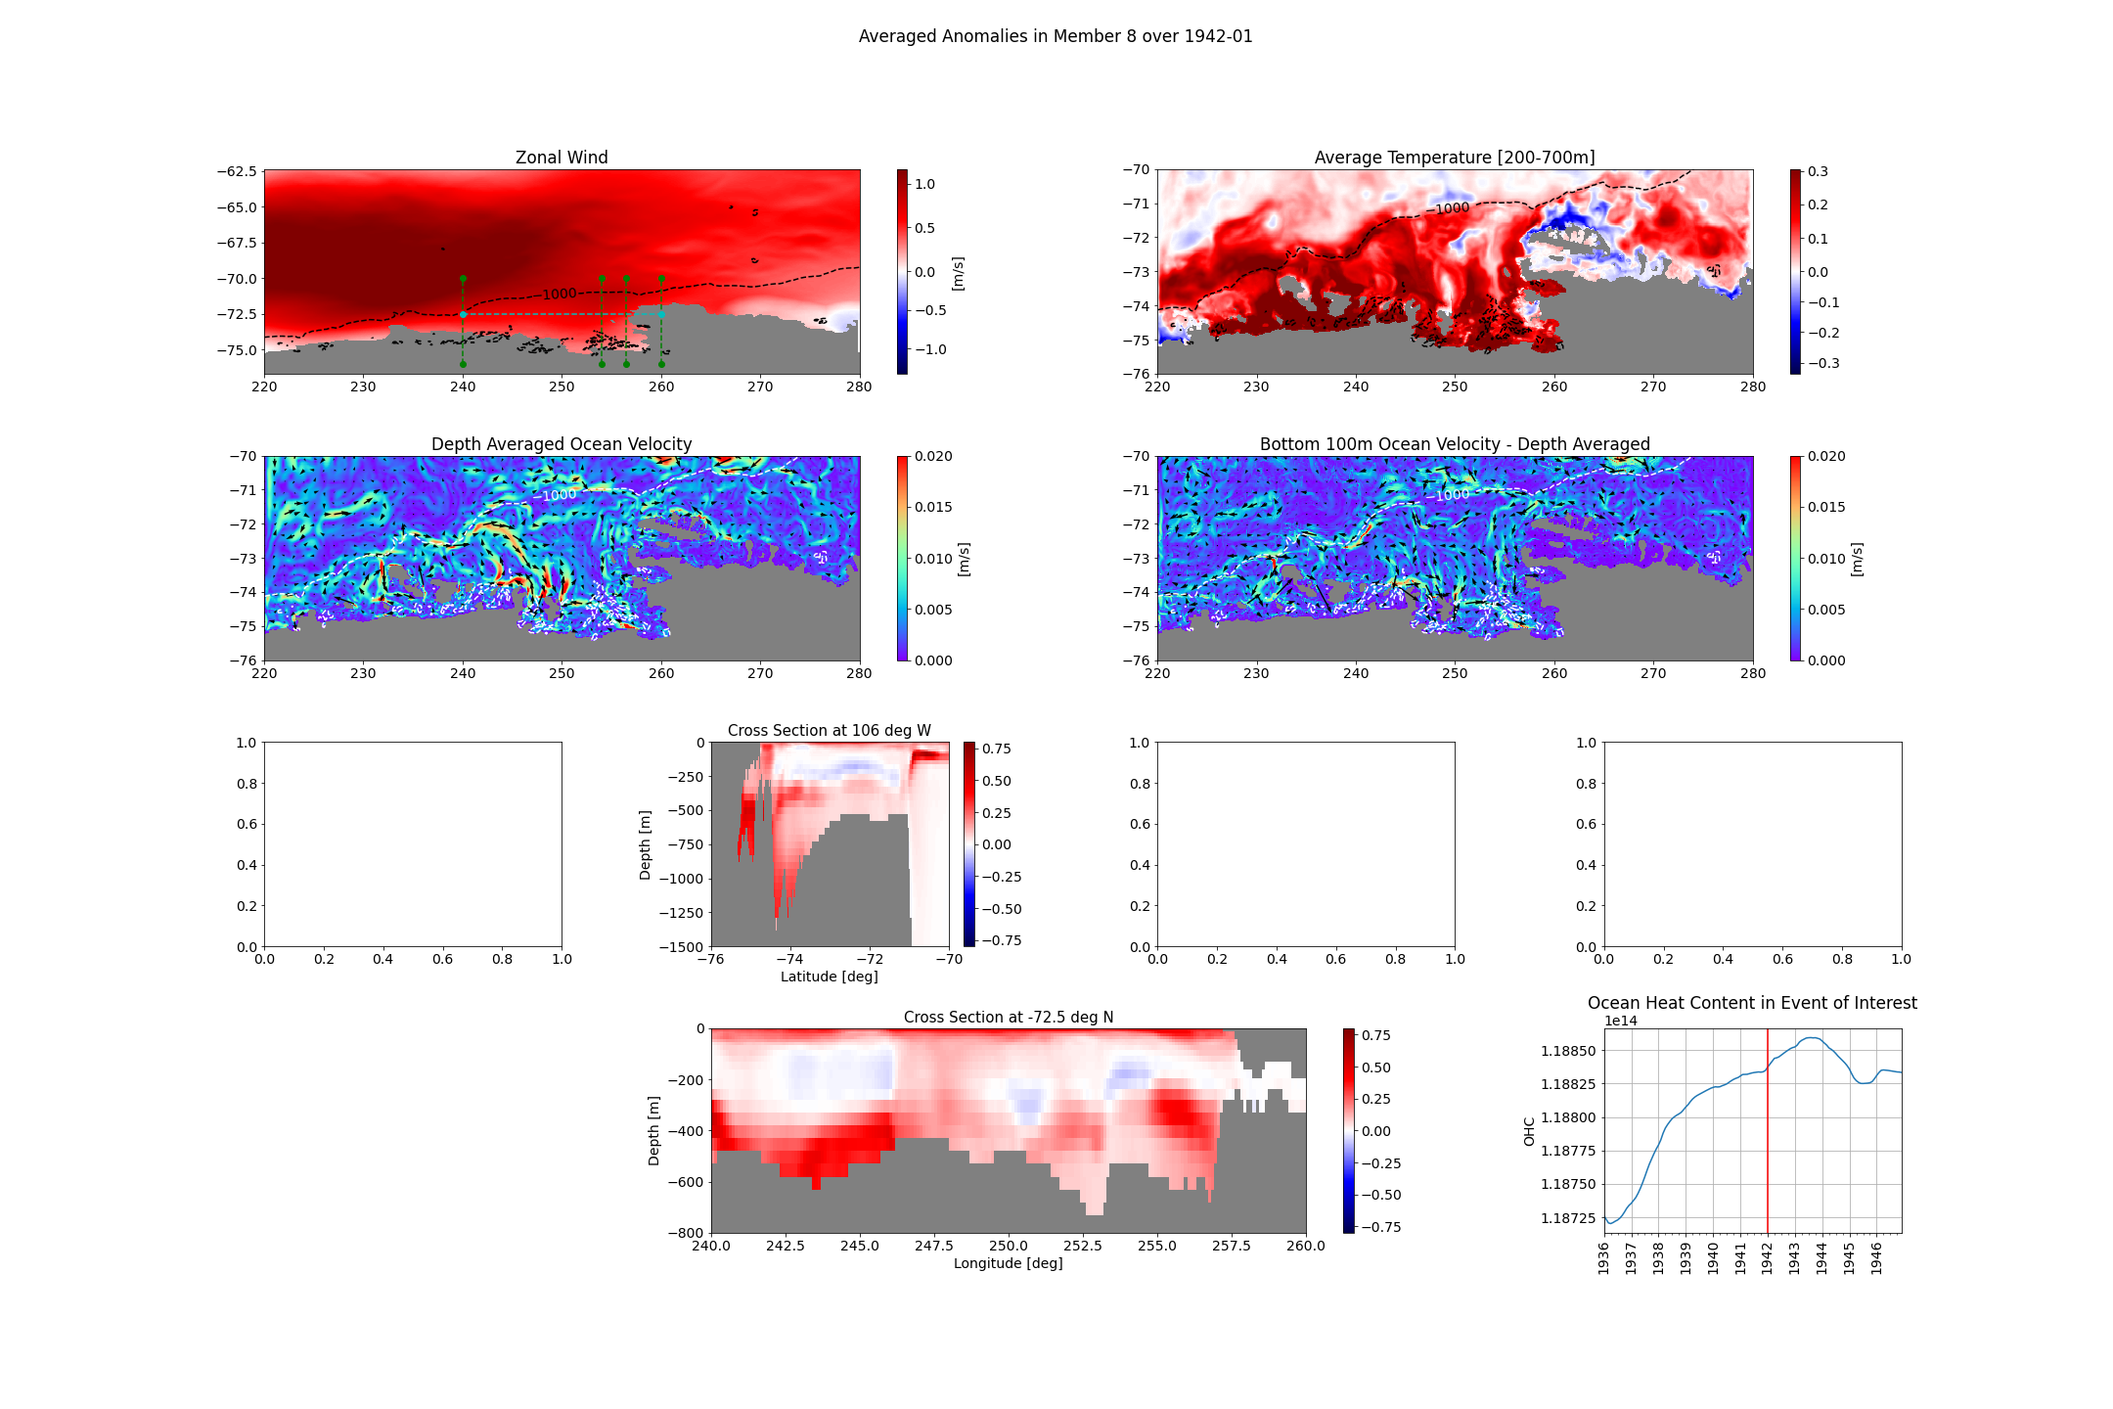

Slide 27
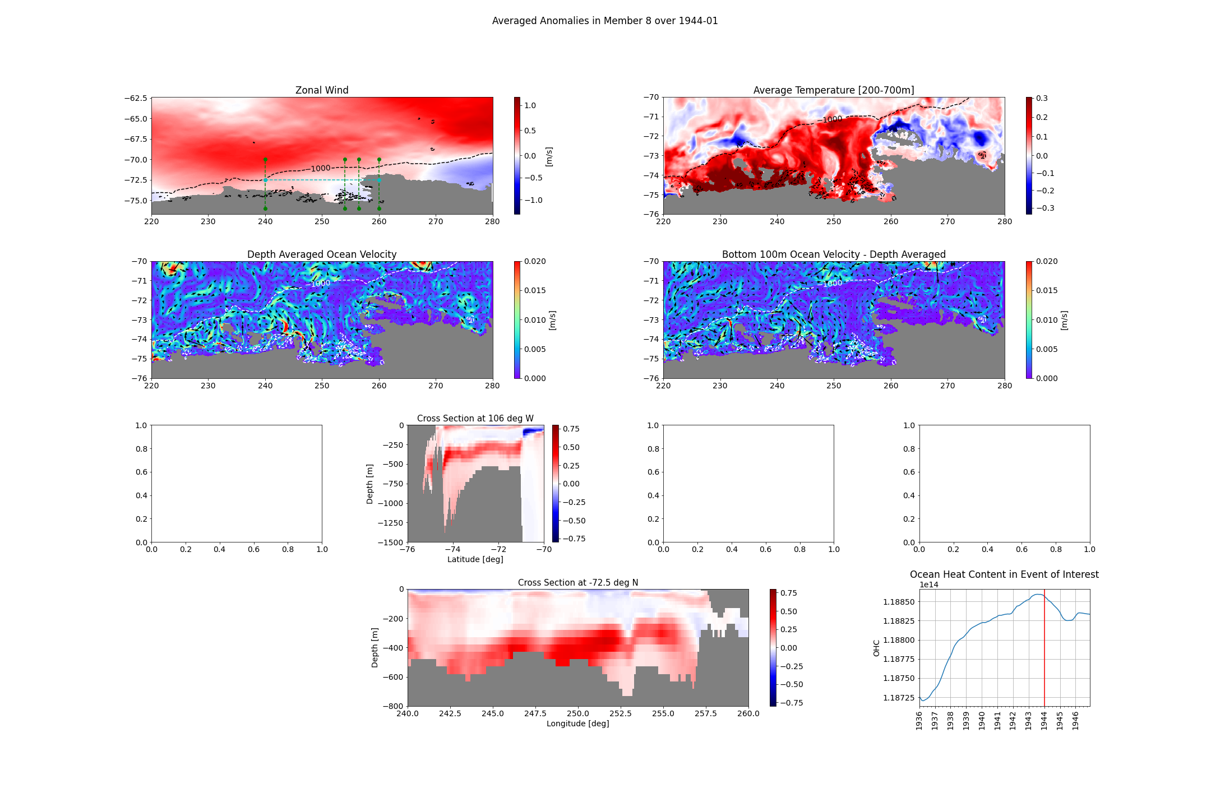

Slide 28
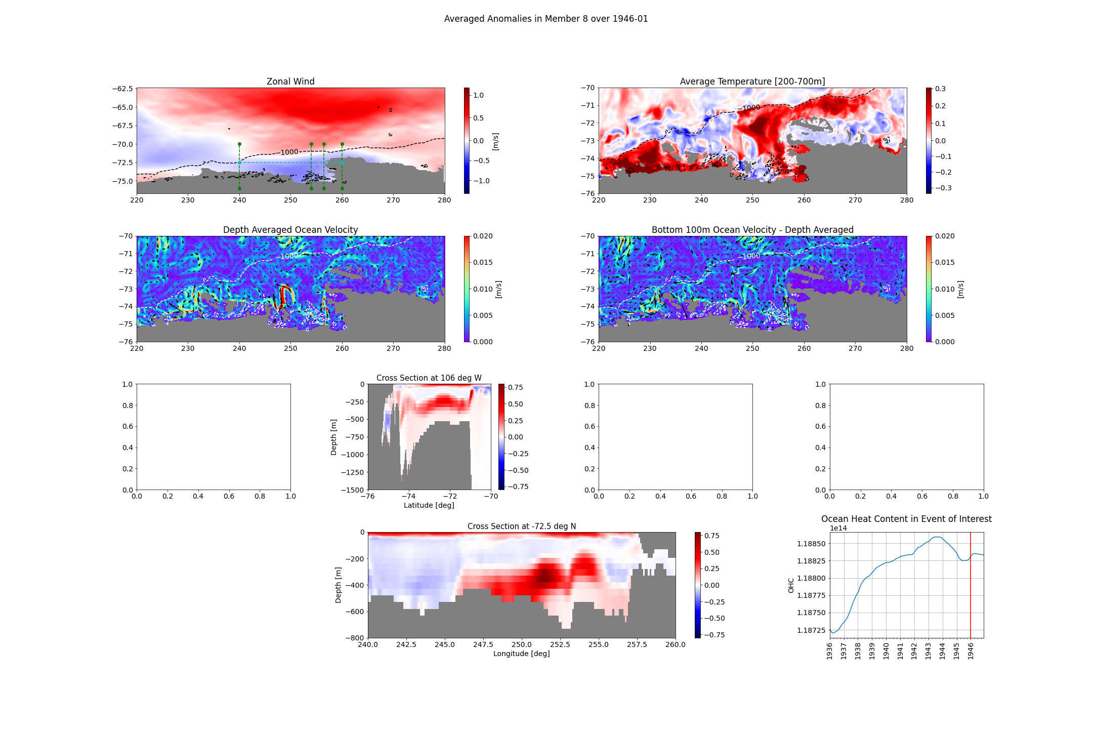

Slide 29
Member 12

Slide 30
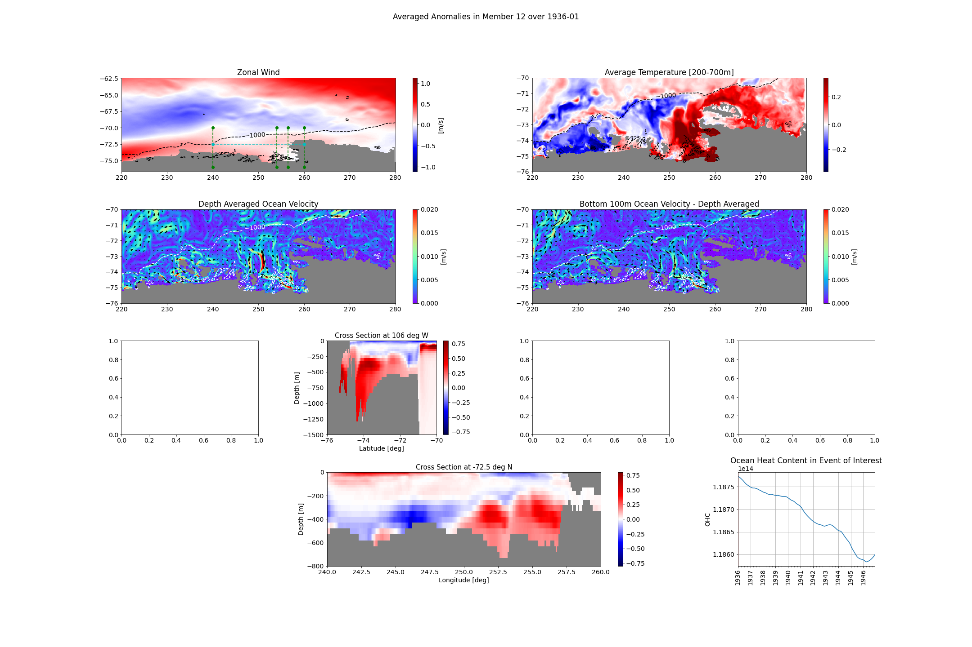

Slide 31
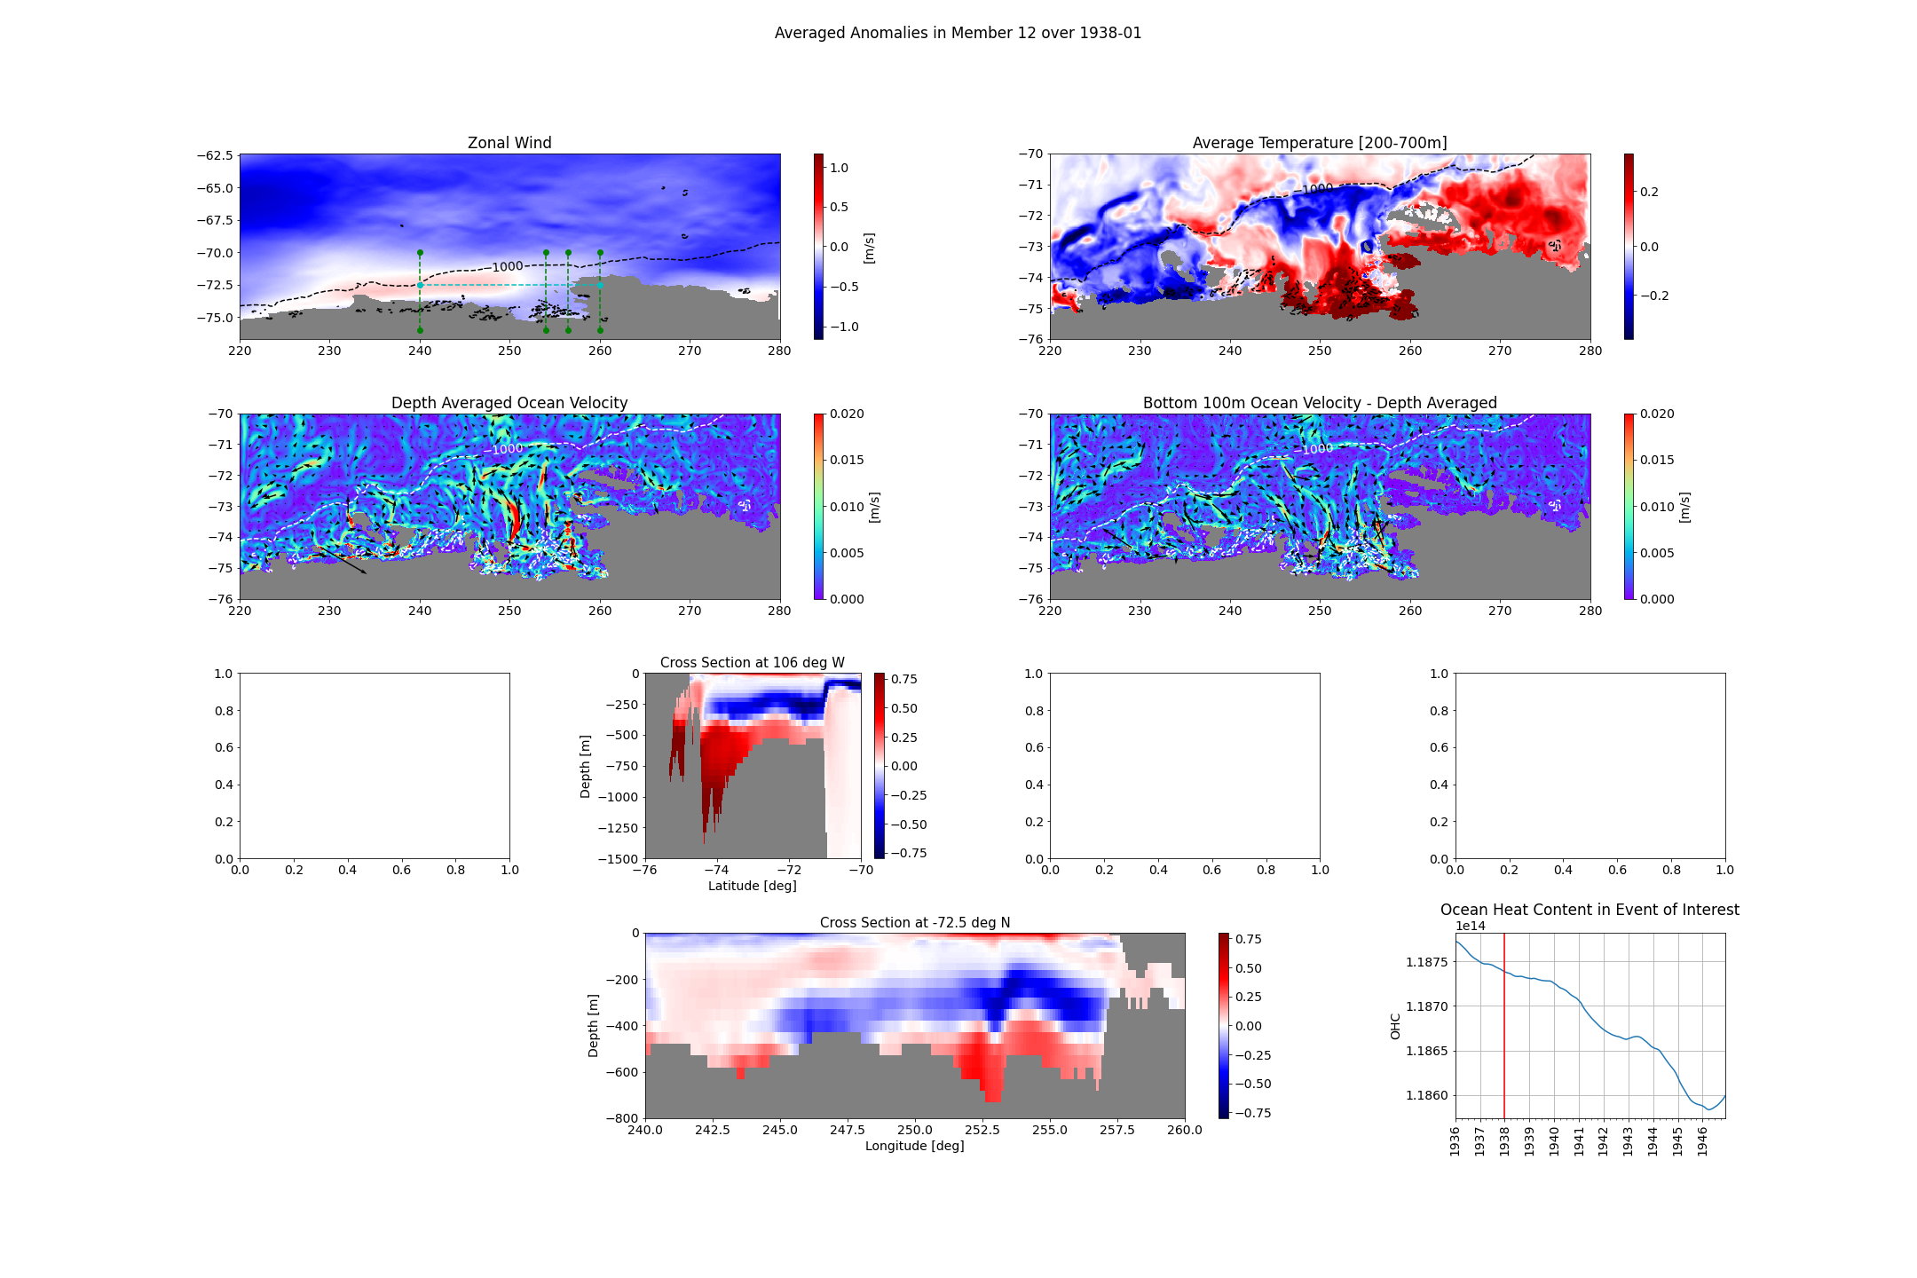

Slide 32
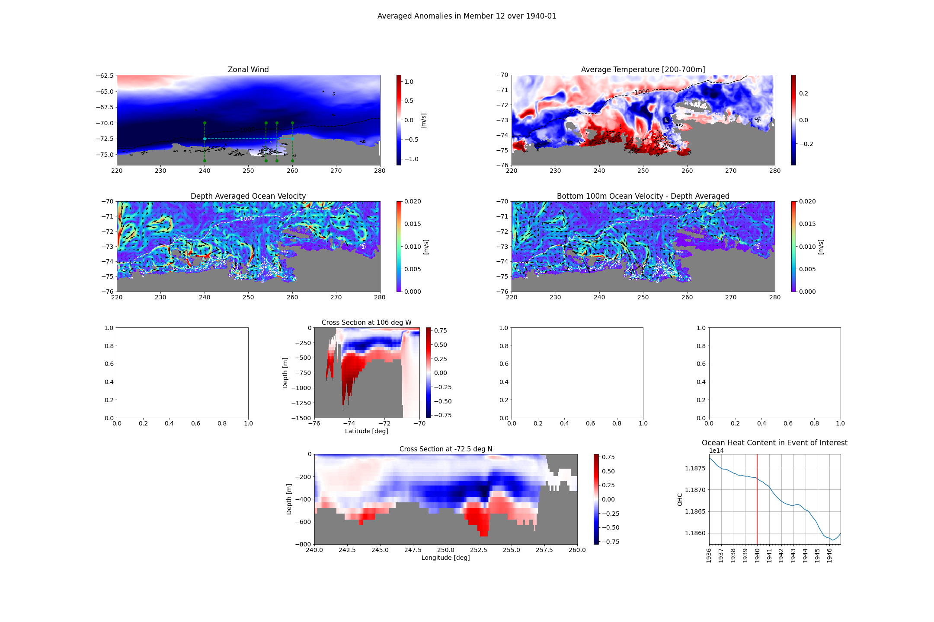

Slide 33
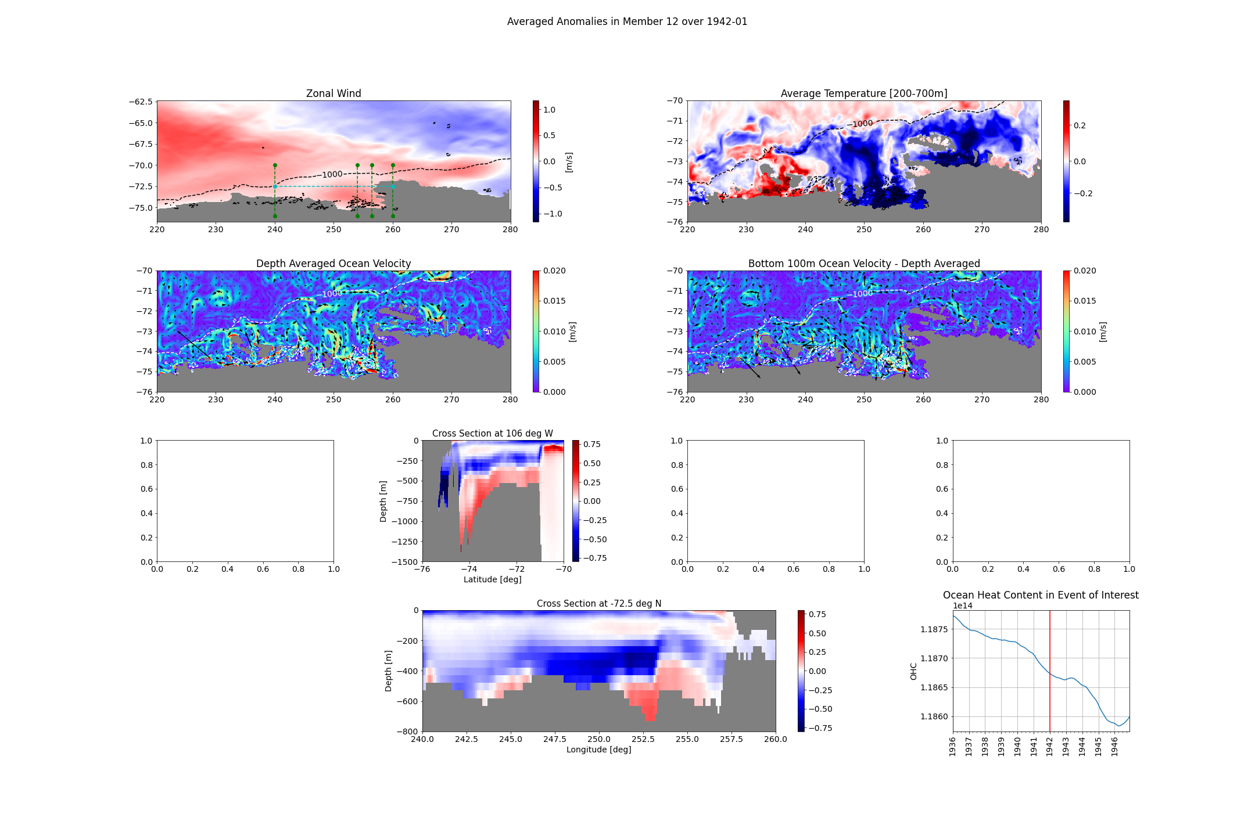

Slide 34
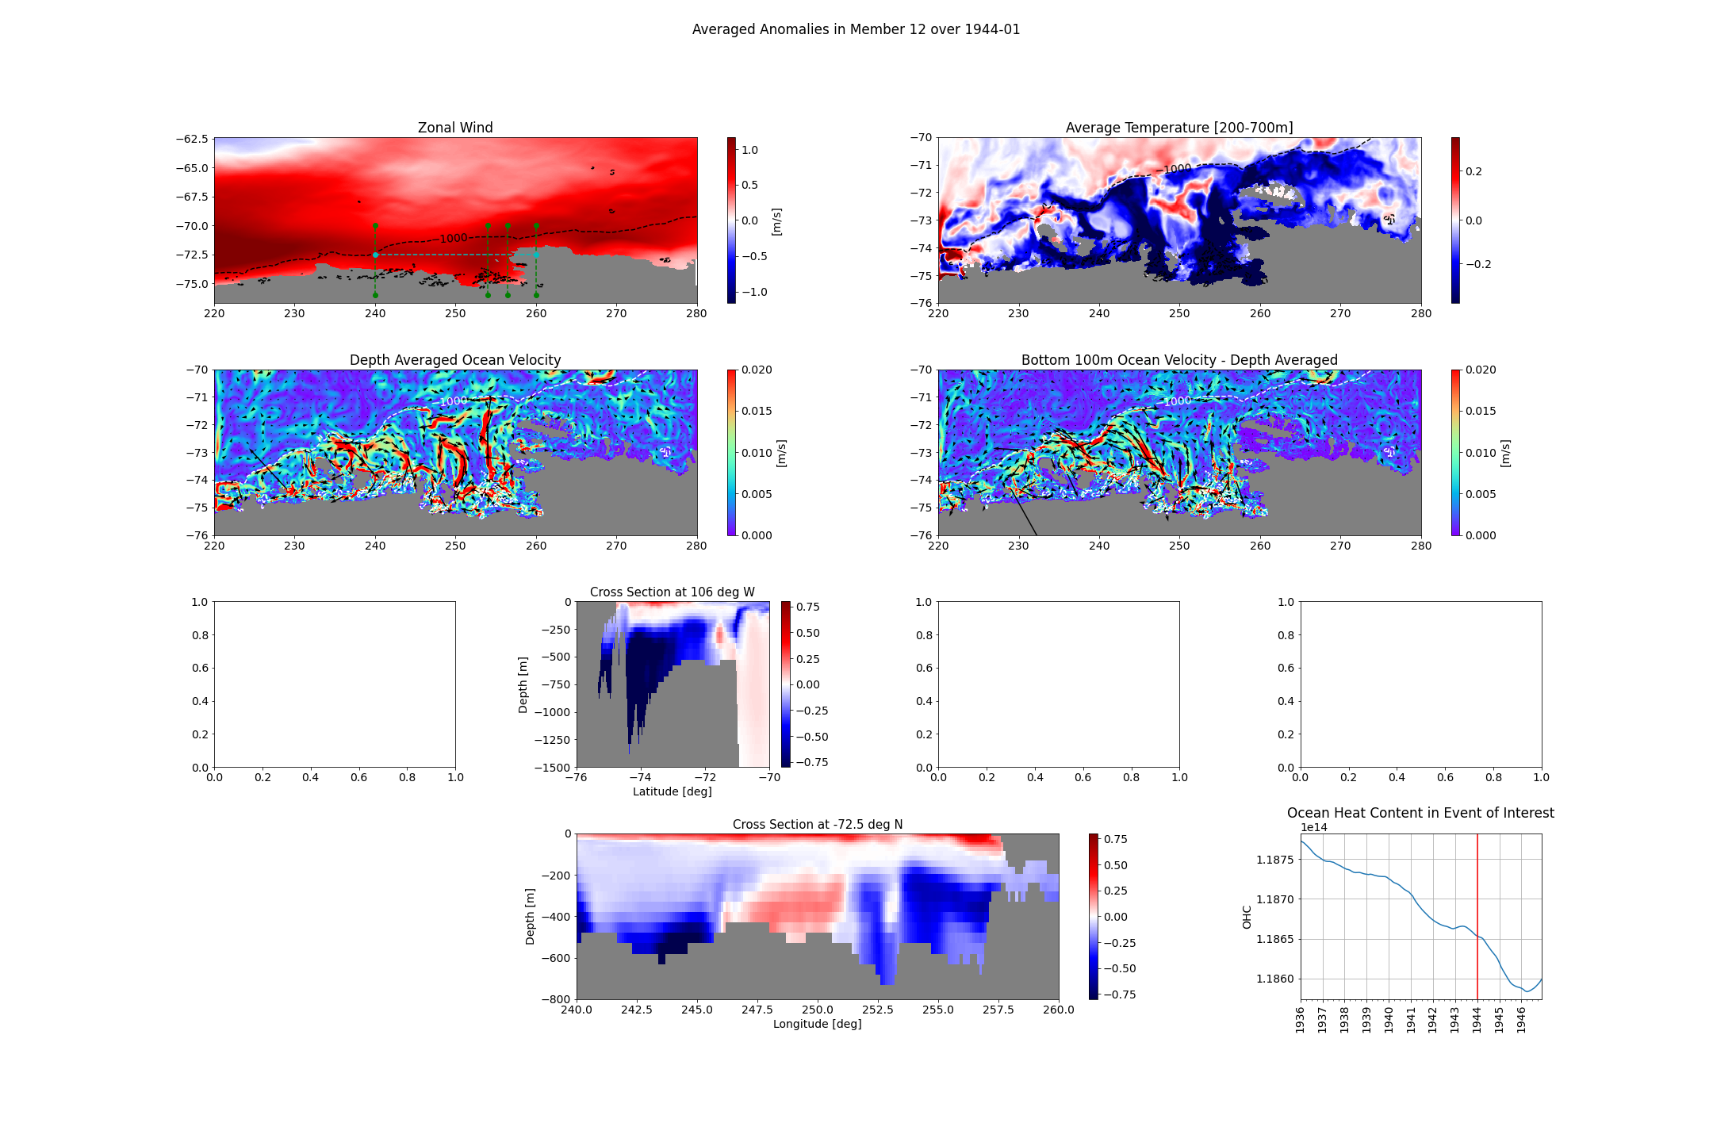

Slide 35
1970s

Slide 36
Member 10

Slide 37
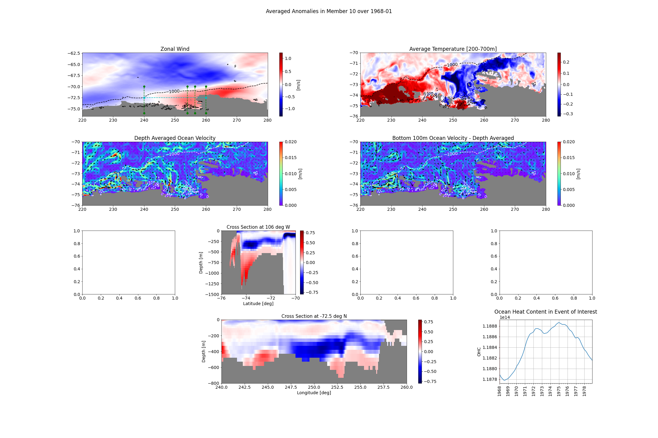

Slide 38
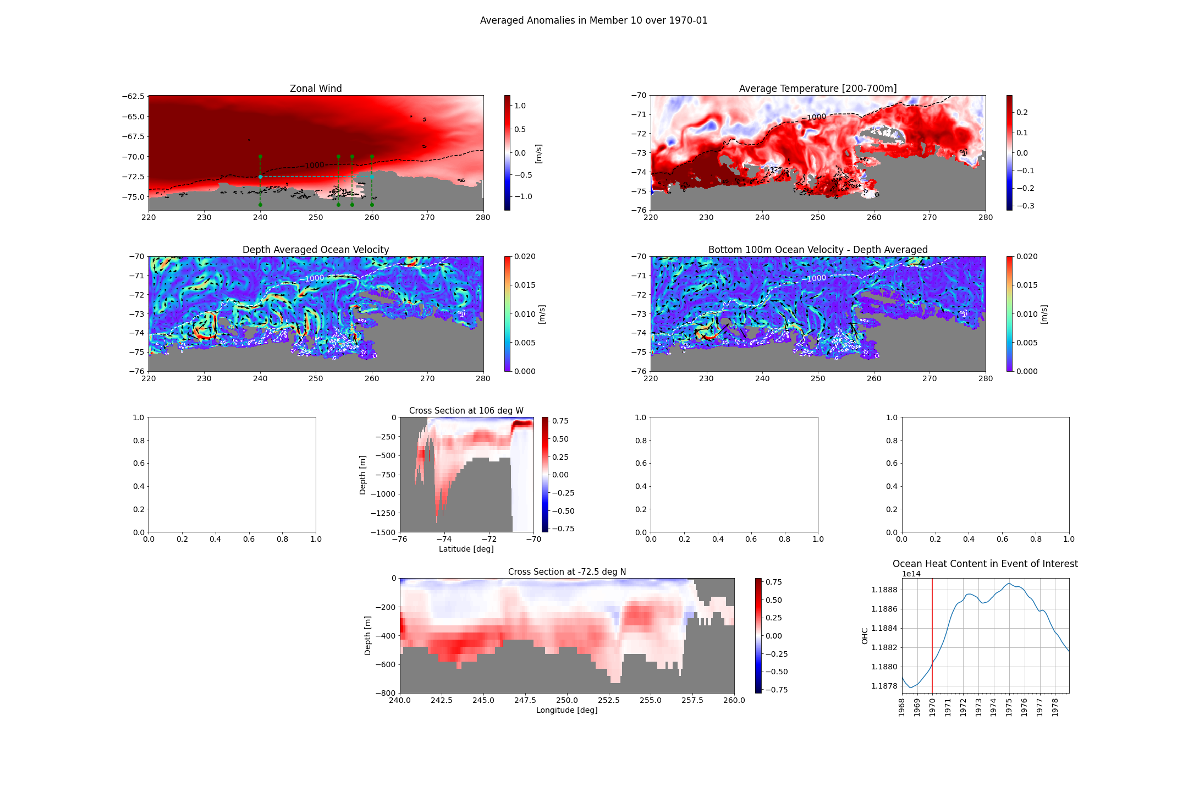

Slide 39
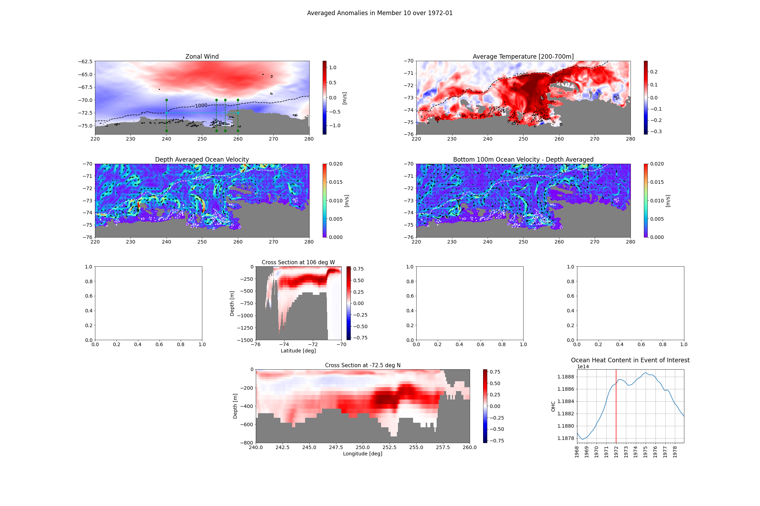

Slide 40
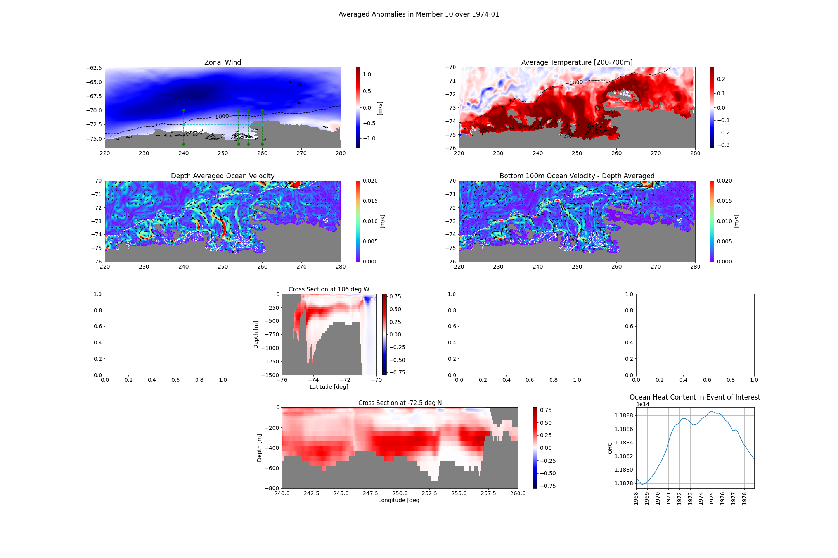

Slide 41
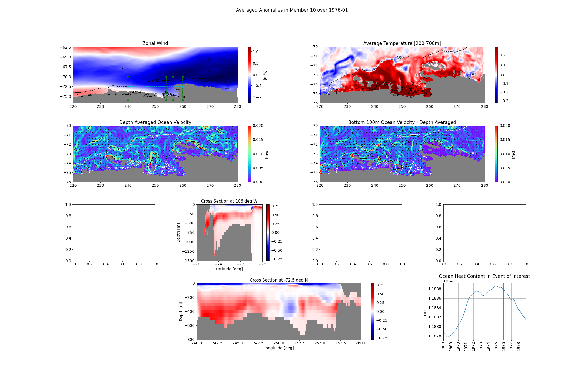

Slide 42
Member 19

Slide 43
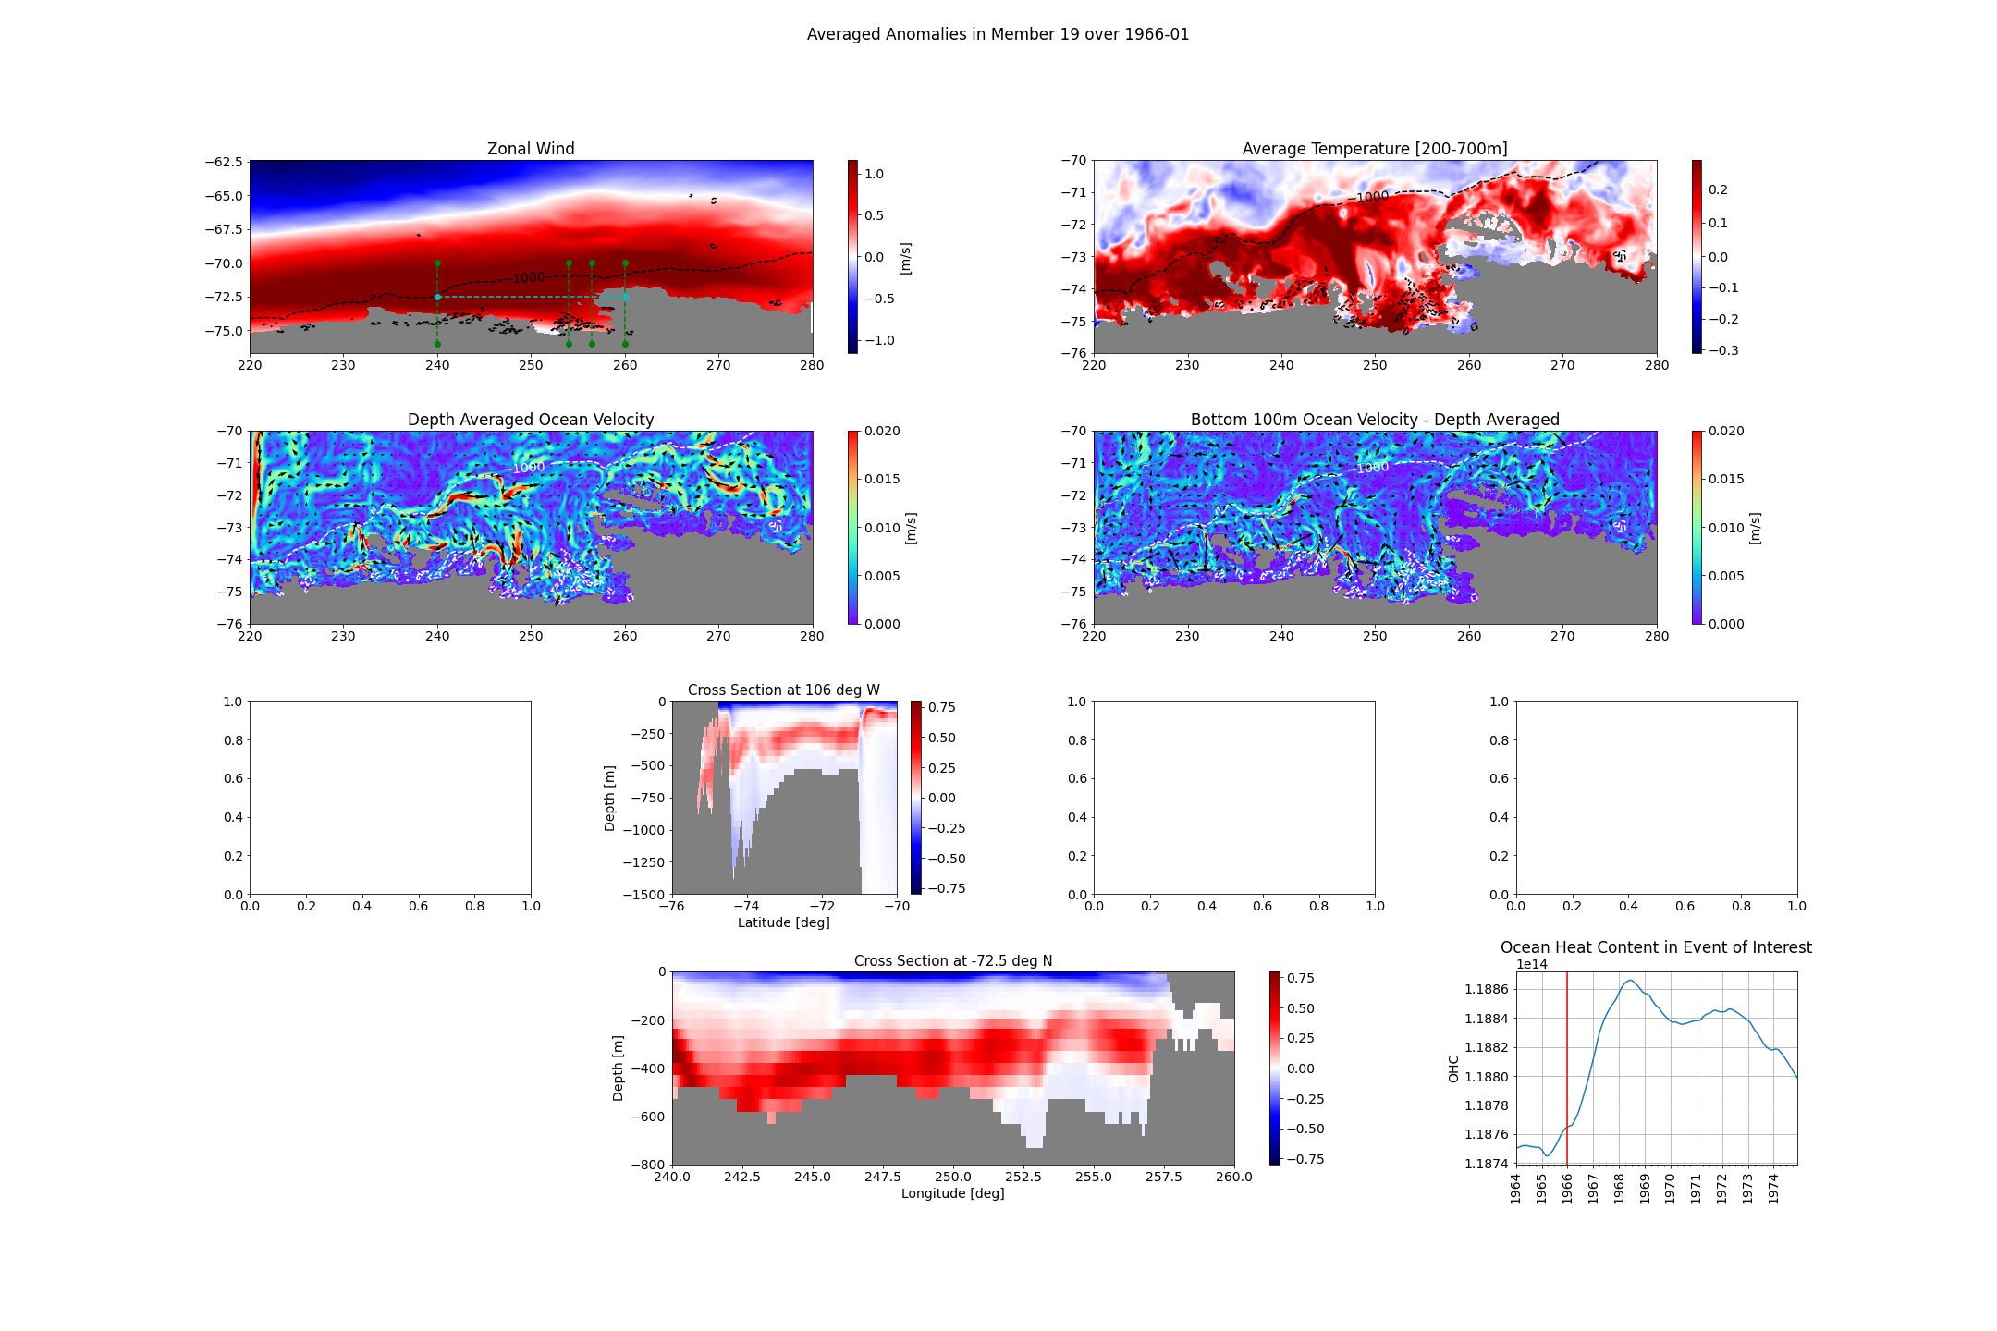

Slide 44
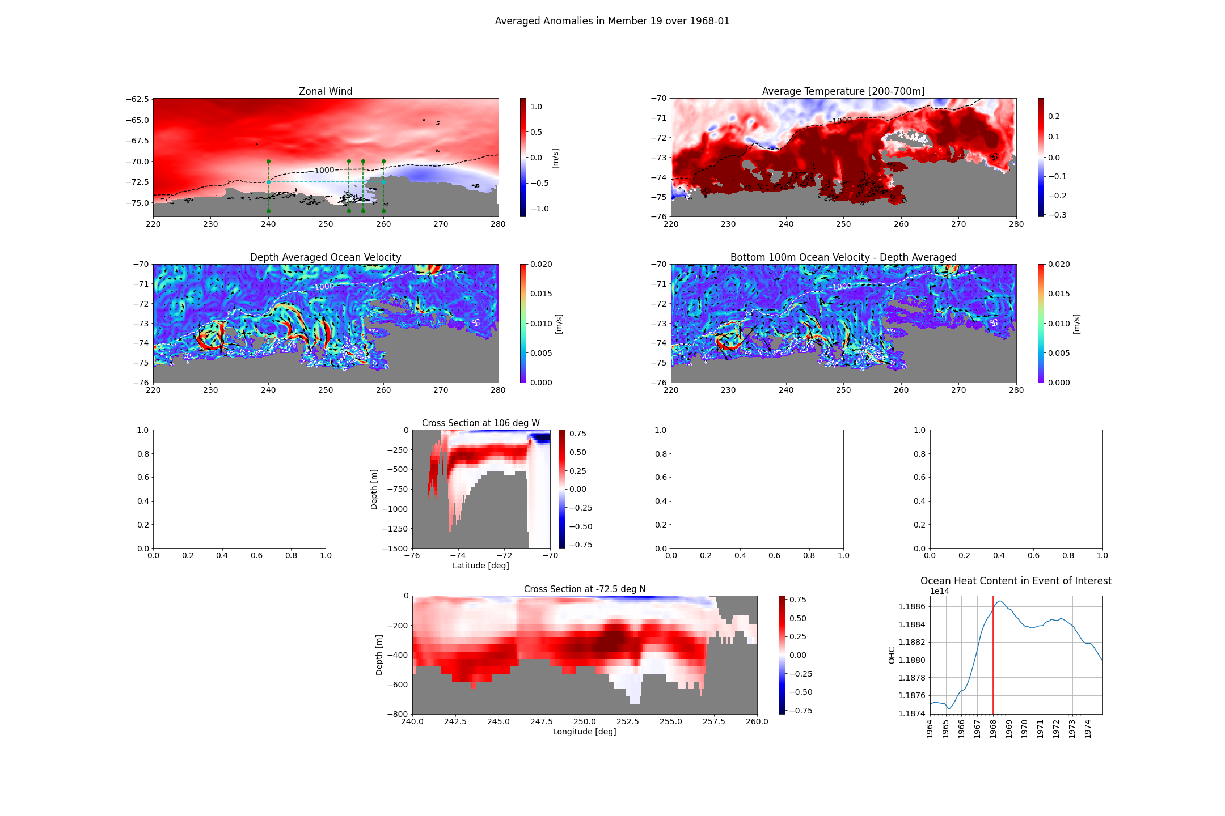

Slide 45
Extra

Slide 46
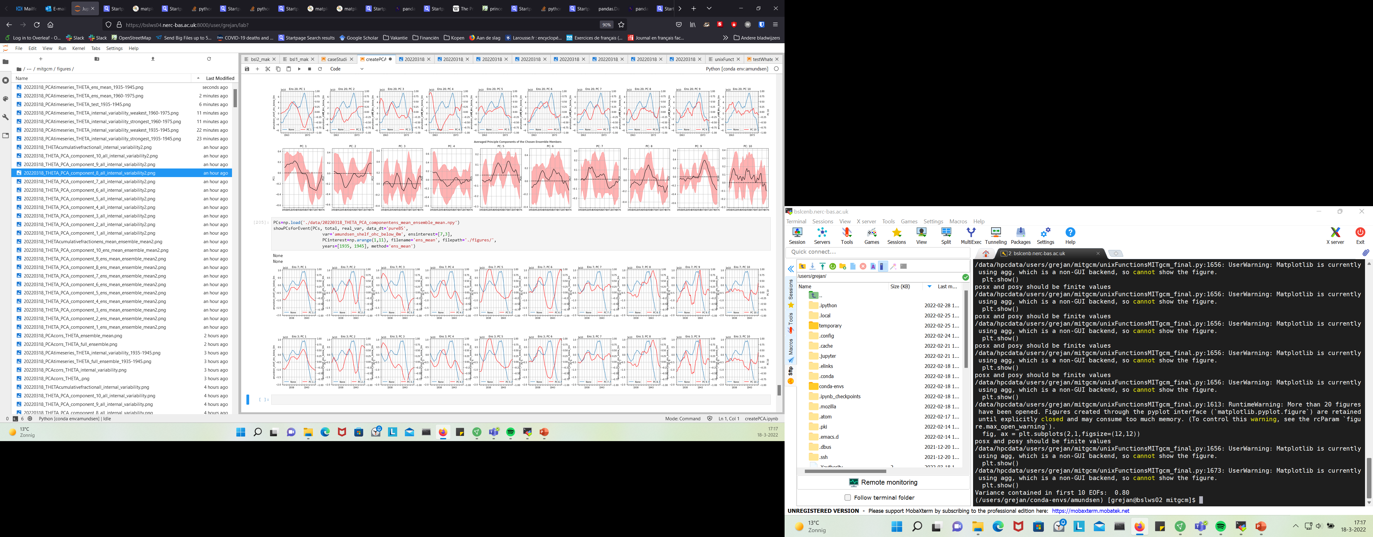
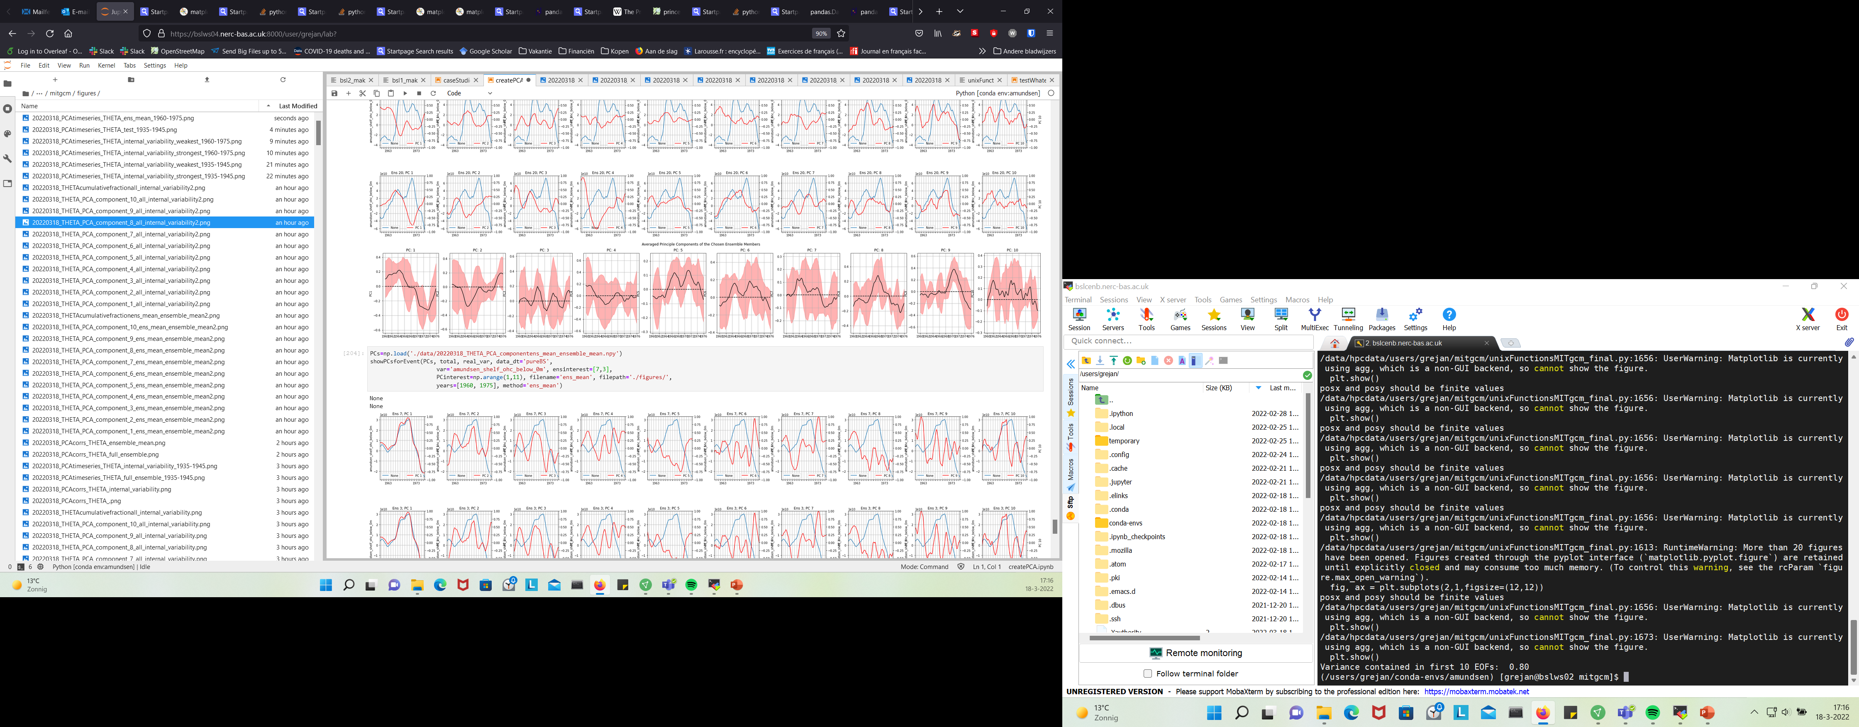
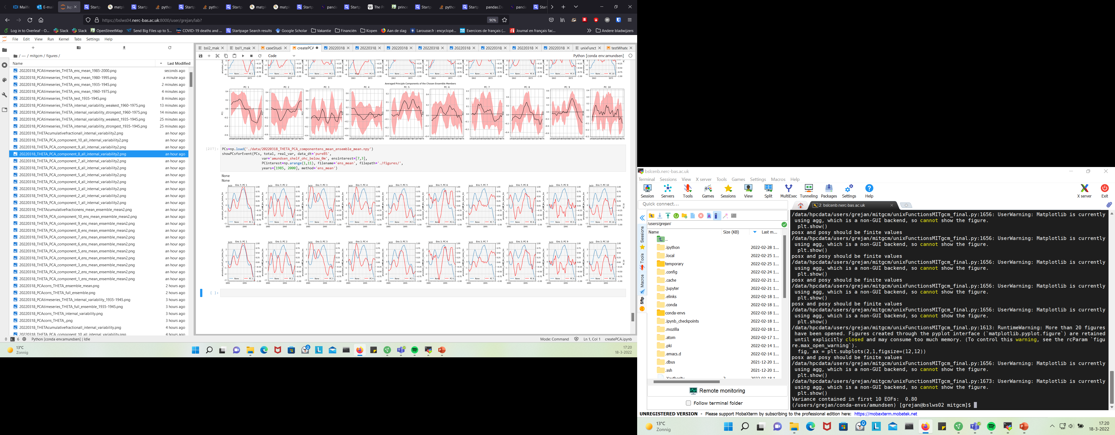
1940
1970
1990

Slide 47
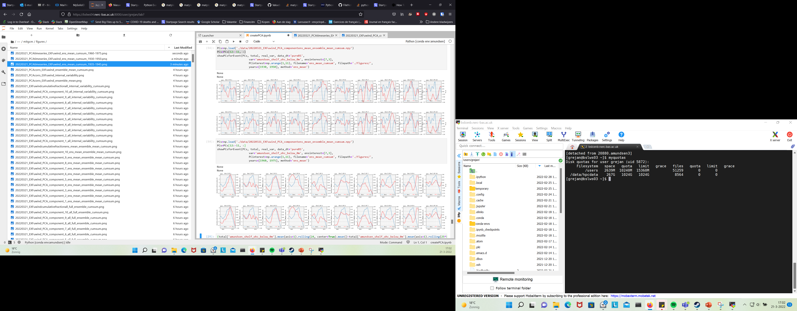
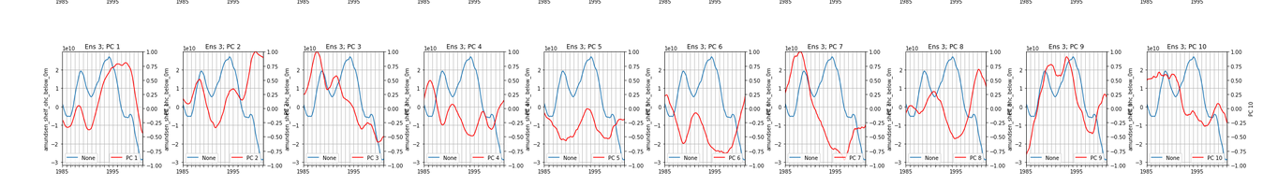

Slide 48
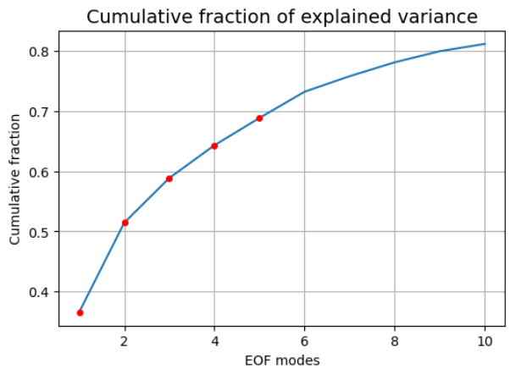
1. PCA of Full Ensemble
First 10 components explain roughly 80 percent of variance

Slide 49
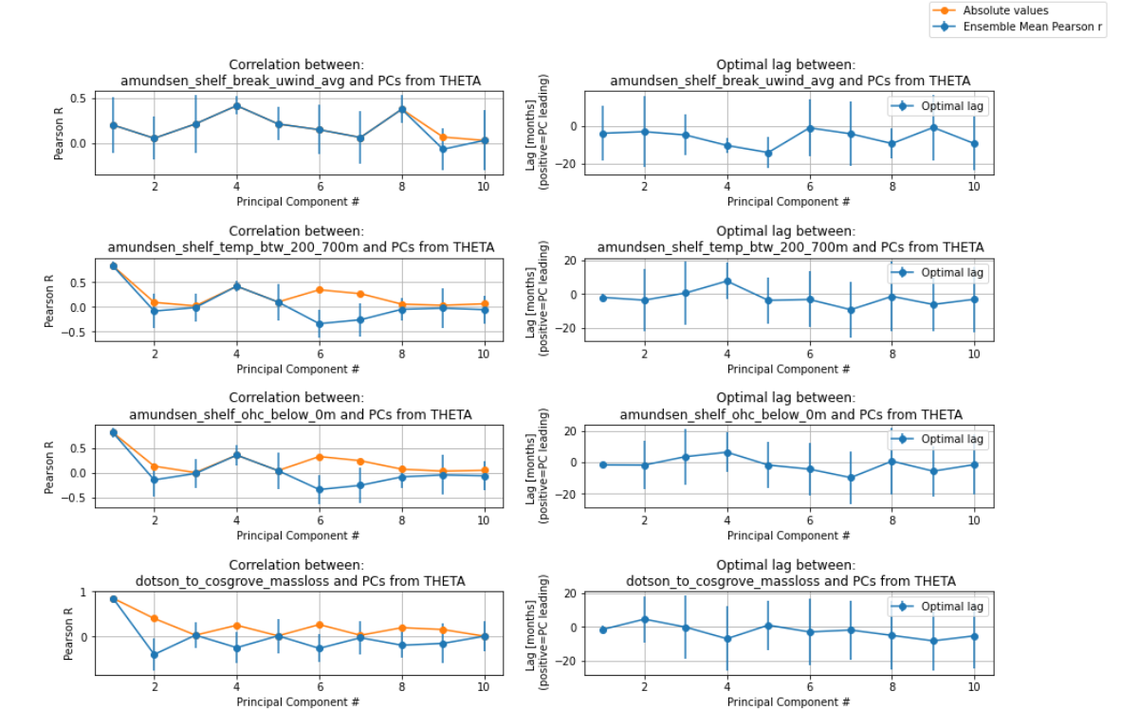

Slide 50
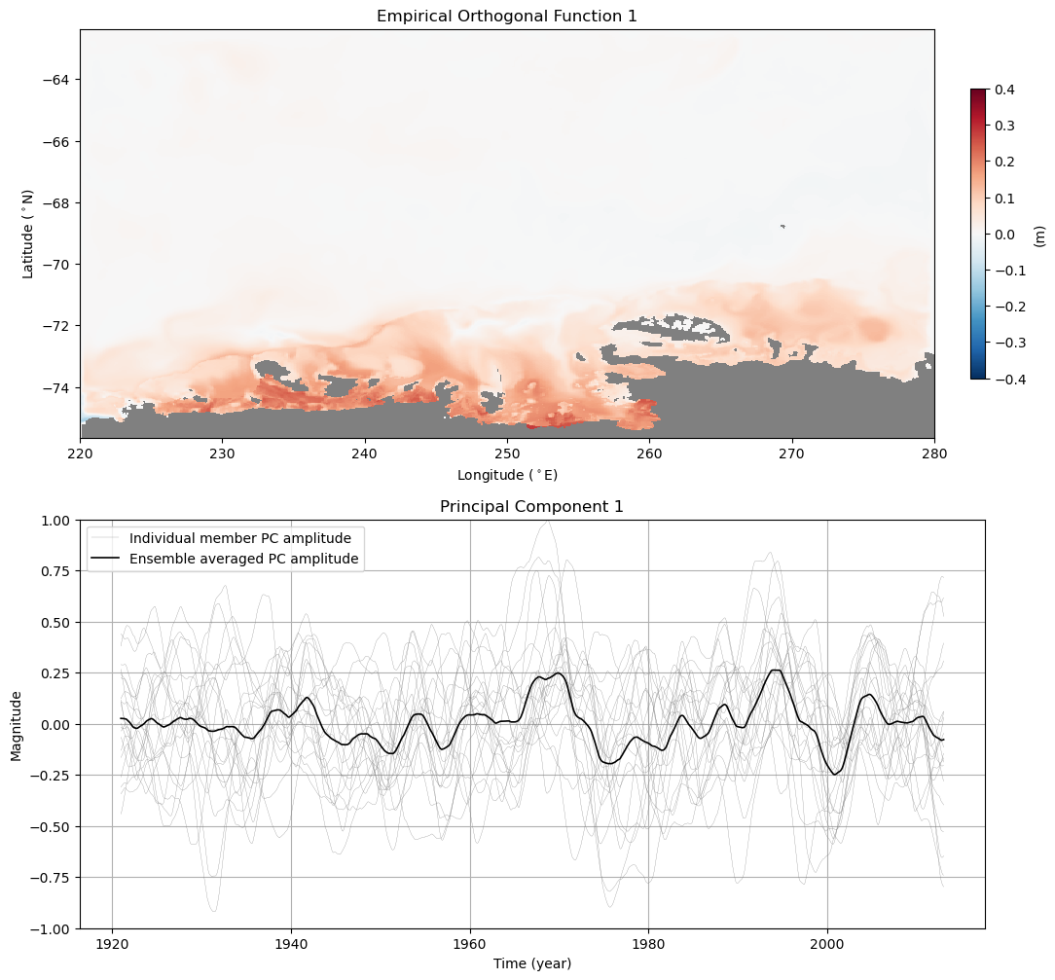

Slide 51
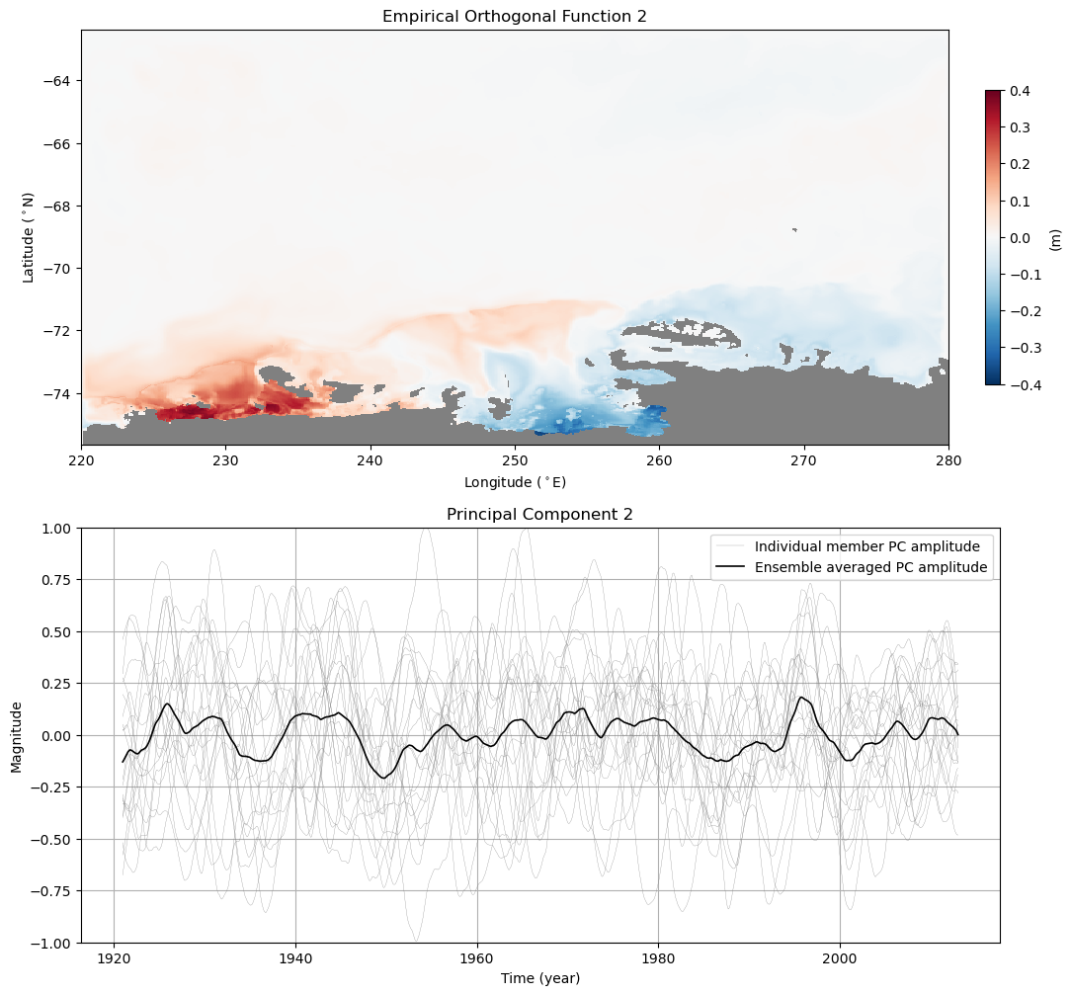

Slide 52
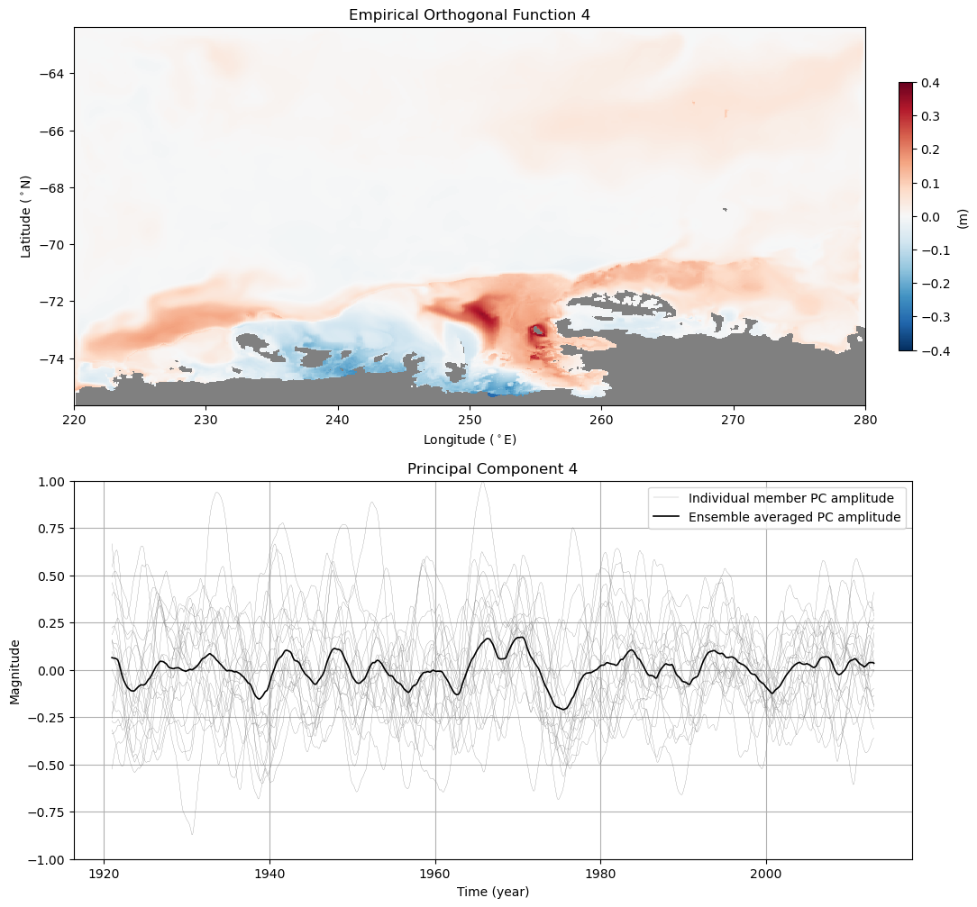

Slide 53
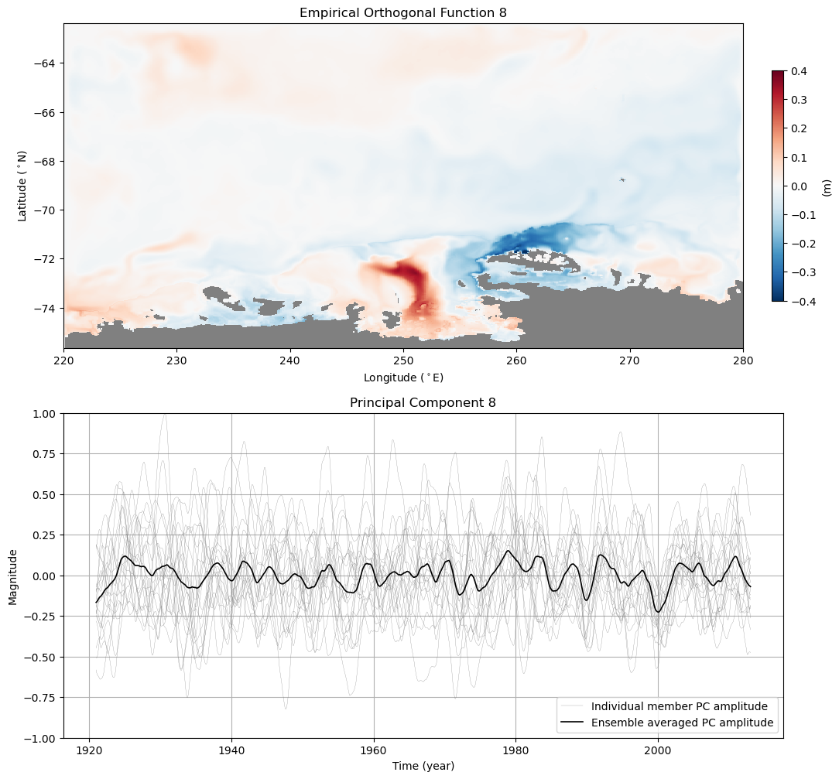

Slide 54
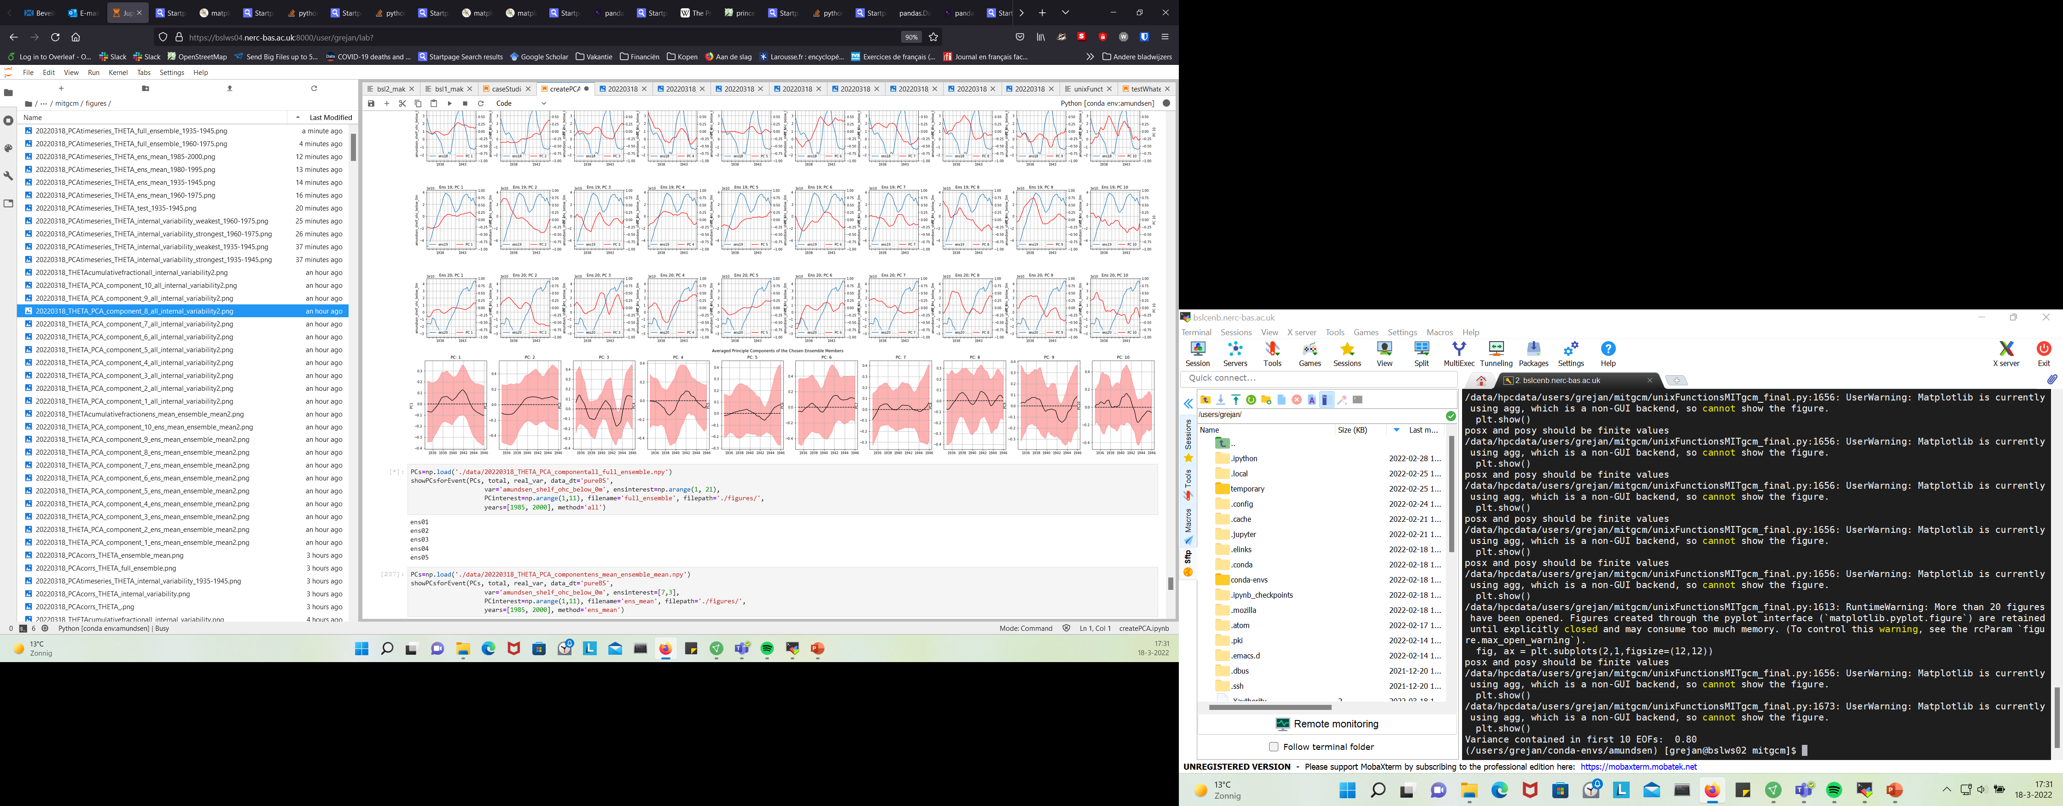
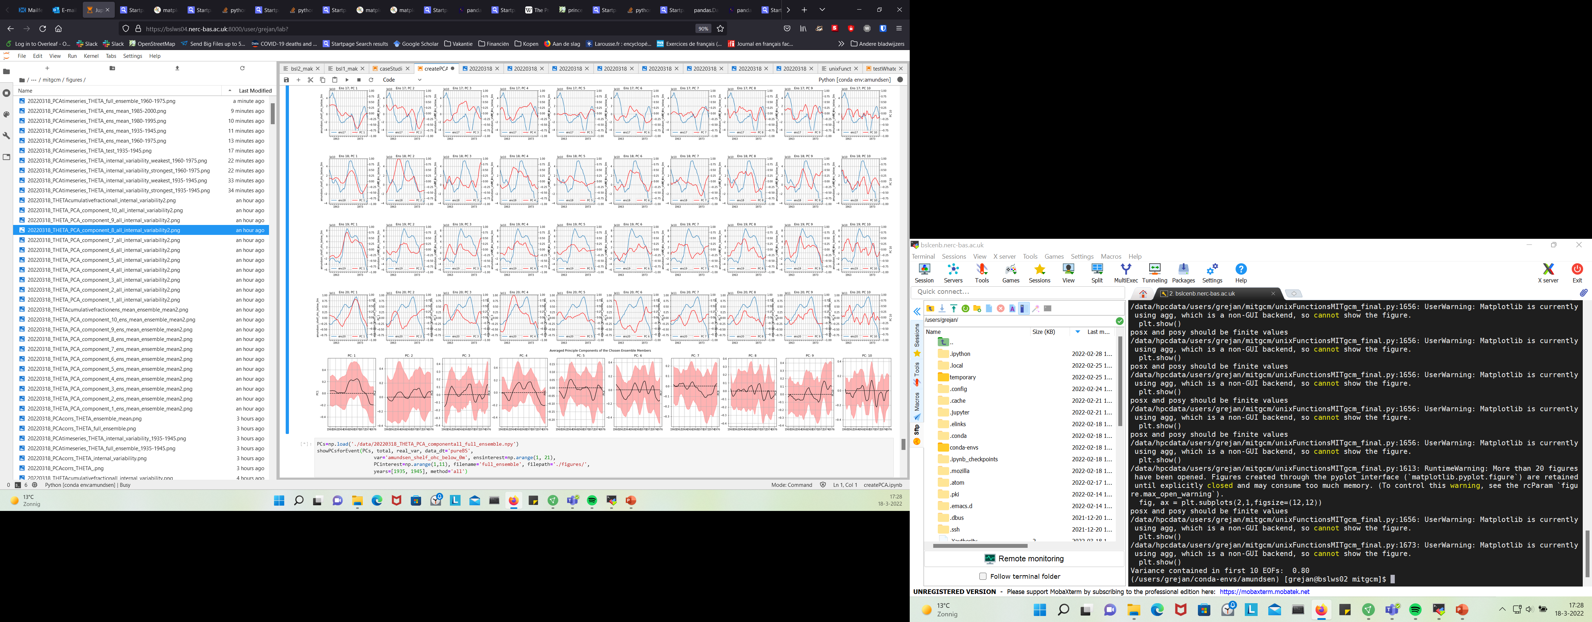
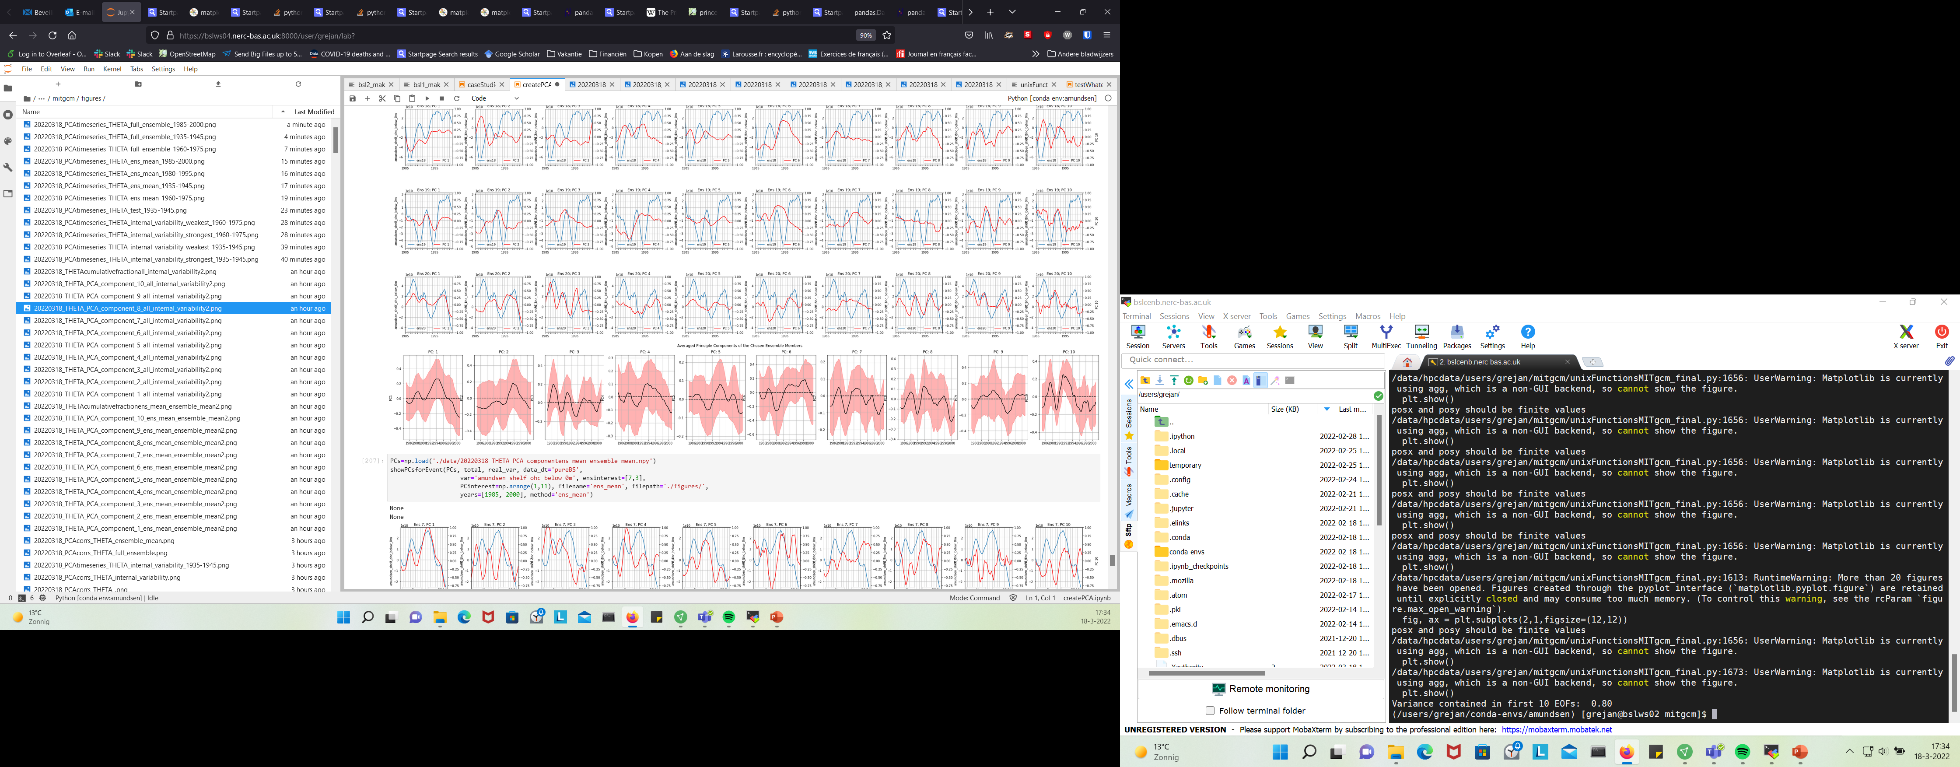
1945
1970
1990

Slide 55
2. PCA of Ensemble Mean
First 10 components explain roughly 90 percent of variance (!)

Slide 64
1940
1970
1990

Slide 65

3. PCA of Internal Variability (Members-Ensemble Mean)
First 10 components explain roughly 80 percent of variance

Slide 66


Slide 67


Slide 68


Slide 69


Slide 70


Slide 71


Strongest
Weakest

Slide 72


Weakest
Strongest

Slide 73



Slide 74
Wind

Slide 75


Slide 76




Slide 78




